Slide 1
Measure Of Central Tendency

Slide 2
Descriptive Statistics
Measure of central tendency
  Mean: It is defined as sum of all observation divide by total number of observation.
  Median: Middle value after sorting the data.
  Mode: Values with highest frequency/ most repeated observation

Slide 3
THE ARITHMETIC MEAN
The arithmetic mean is the statistician’s term for what the layman knows as the average. It can be thought of as that value of the variable series which is numerically MOST representative of the whole series.
“The arithmetic mean or simply the mean is a value obtained by dividing the sum of all the observations by their number.”

Slide 4
Contd.
Formula of Mean is :
where n represents the number of observations in the sample that has been the ith observation in the sample (i = 1, 2, 3, …, n), and represents the mean of the sample.
For simplicity, the above formula can be written as:

Slide 5
Example
Information regarding the receipts of a news agent for seven days of a particular week are given below:
Mean sales per day in this week:
= £ 259.85/7 = £ 37.12 (to the nearest penny).

Slide 6
Mean Of Grouped Data
In case of a frequency distribution, the arithmetic mean is defined as:

Slide 7
For simplicity, the above formula can be written as
EPA MILEAGE RATINGS OF 30 CARS OF A CERTAIN MODEL

Slide 8
The mid-point of each class is obtained by adding the sum of the two limits of the class and dividing by 2.
Hence, in this example, our mid-points are computed in this manner:
30.0 plus 32.9 divided by 2 is equal to 31.45,
33.0 plus 35.9 divided by 2 is equal to 34.45,

Slide 9
Applying the formula:
We obtain:

Slide 10
Median
If the scores in a distribution are listed in order from smallest to largest, the median is defined as the midpoint of the list.
The median divides the scores so that 50% of the scores in the distribution have values that are equal to or less than the median.
Computation of the median requires scores that can be placed in rank order (smallest to largest) and are measured on an ordinal, interval, or ratio scale.

Slide 11
Contd.
Usually, the median can be found by a simple counting procedure:
1. With an odd number of scores, list the values in order, and the median is the middle score in the list.
2. With an even number of scores, list the values in order, and the median is half-way between the middle two scores.

Slide 12

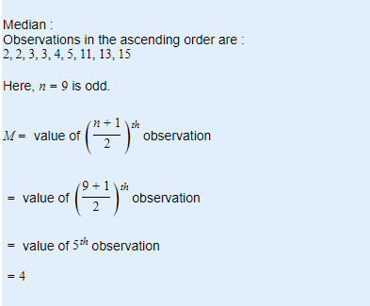
Median of Ungrouped data using Formula
Formula
Example:

Slide 13
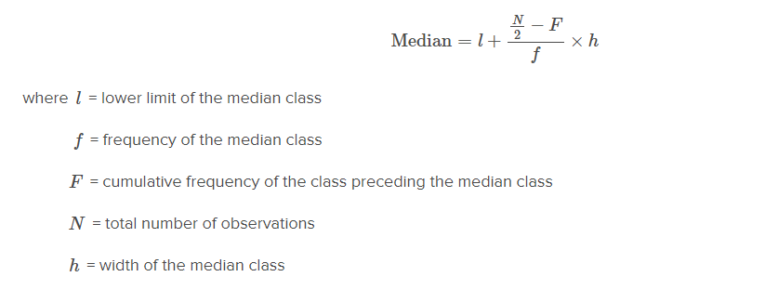
Median of Grouped Data

Slide 14
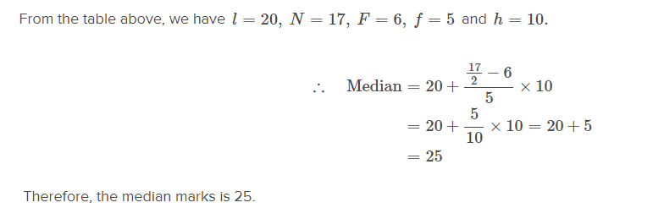

Slide 15
Mode
The most frequent number—that is, the number that occurs the highest number of times.
Example: The mode of {4, 2, 4, 3, 2, 2} is 2 because it occurs three times, which is more than any other number.

