Slide 1
Advance Operating System

Slide 2
Today’s Agenda
File System
How File System Works
Design issues and Challenges of File system
File and Directory
Basic Operations
Sync and Seek System Call
File access methods
Directory
Steps in fully Qualified Path
File protection

Slide 3
File System
File System is Major Functionality of os
File System is software module inside OS code which manage files
Common File System
    Window used NTFS File system
    Dos windows used FAT file System
    Unix used Unix file System
    Linux used extend file system
Notes:
Lect 703-29
https://www.youtube.com/watch?v=0LtuQhNFFe0&list=PLxCzCOWd7aiGz9donHRrE9I3Mwn6XdP8p&index=79

Slide 4
How File System Works
Function of File System
    How data stored in File
    How data fetch on file
How user stored data
  File form-> Folder( Unix-Directory)
Who manage folder
  File system (NTFS)
  User cannot know how Manage folder
File System
- stored data on sector
-Download 1 GB movie

Slide 5
How File System Works of File System
For Example USER Download 1 GB movie
File System perform following steps
- Divide 1 GB file in block

Slide 6
Design Issues and Challenges of File Systems
Save in HD such way that it can easily search and get back , reading an access will be easy
Disk Management
  How file are manage in disk
Fast access
Performance issue
  fast access from Hd
Consistency
  Computer shutdown in middle of file writing
  Two process access same file
Notes:
CS703-29

Slide 7
File and Directory
A file is a collection of data with some properties
  contents, size, owner, last read/write time, protection
Unix OS Handle all input device as File
Directory
File Name
  Extension
Notes:
CS703-29

Slide 8
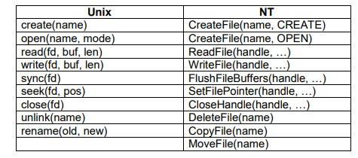
Basic Operation

Slide 9
Sync and Seek
System Call
Sync linux
Buffer Cash, System Call
Seek

Slide 10
File access methods
File access methods
Sequential access
  read bytes one at a time, in order
Direct access
  random access given a block/byte number •
Record access
  file is array of fixed- or variable-sized records •
Indexed access
  FS contains an index to a particular field of each record in a file
apps can find a file based on value in that record (similar to DB)

Slide 11
Directory
Most file systems support multi-level directories
  naming hierarchies (/, /usr, /usr/local, /usr/local/bin, …)
Most file systems support the notion of current directory
  absolute names: fully-qualified starting from root of FS
  bash$ cd /usr/local
relative names: specified with respect to current directory
  bash$ cd /usr/local (absolute)
  bash$ cd bin (relative, equivalent to cd /usr/local/bin)
Notes:
23

Slide 12
Steps in fully Qualified Path
/root directory
one /
Two/
/Three
Cashing

Slide 13
File protection
Authentication
  Who exactly are you
Authorized
  What exactly you can do

Slide 14
File Allocation Methods
Allocation methods
  Contiguous method and Non Contiguous method
Advantages
  Efficient Disk utilization
  Access Fast
Notes:
https://www.youtube.com/watch?v=J6wVO4pvUCw&list=PLxCzCOWd7aiGz9donHRrE9I3Mwn6XdP8p&index=81

