Slide 1
Advance Operating System

Slide 2
Today’s Agenda
P1 Paging vs Segmentation
P2 How Segmentation Works
P3 First Fit Algorithm
P4 Next Fit Algorithm
P5 Best Fit Algorithm
P6 Worst Fit Algorithm
P7 Advantages and Disadvantages of Memory Allocation Methods File

Slide 3
What is Segmentation
In Operating Systems, Segmentation is a memory management technique in which, the memory is divided into the variable size parts. Each part is known as segment which can be allocated to a process.
Why Segmentation is required?
  Paging is more close to Operating system rather than the User
  Without knowing the code
  It decreases the efficiency of the system
  Operating system doesn't care about the User's view of the process
Notes:
CS703-25
https://www.javatpoint.com/os-segmentation#:~:text=In%20Operating%20Systems%2C%20Segmentation%20is,table%20called%20as%20segment%20table.

Slide 4
What is Segmentation
Knowing before divide code
Every segment have variable size
User views
Notes:
CS703-25

Slide 5
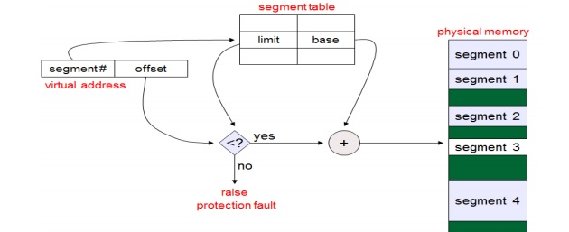
Segment lookups
Notes:
CS703-25
11:24

