Slide 1
Advance Operating System

Slide 2
Today’s Agenda
What is OS?
How Memory is Organized
How OS improve the CPU utilization
What is Memory Management¹?
Virtual Memory Management
Embedded System and Desktop System
How VM Works
(page fault, page replacing)
Linker and Loader
Swapping
Memory Hierarchy
Notes:
Udacity:Lesson 1

Slide 3
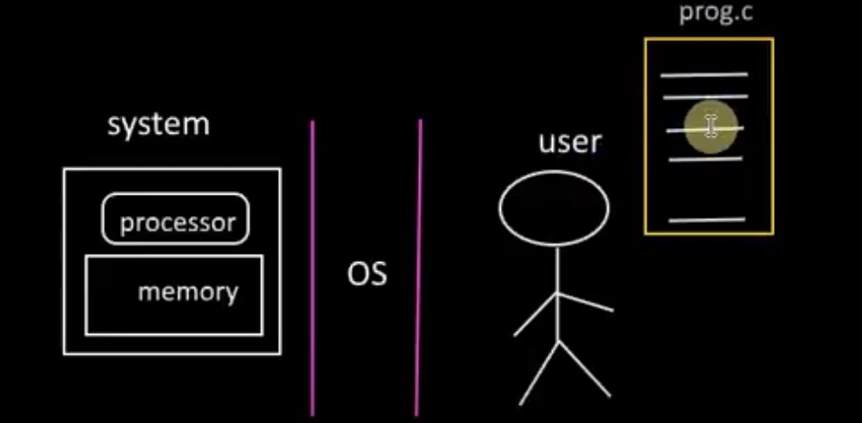
What is OS?
Notes:
https://www.youtube.com/watch?v=392uyAUJqO4

Slide 4
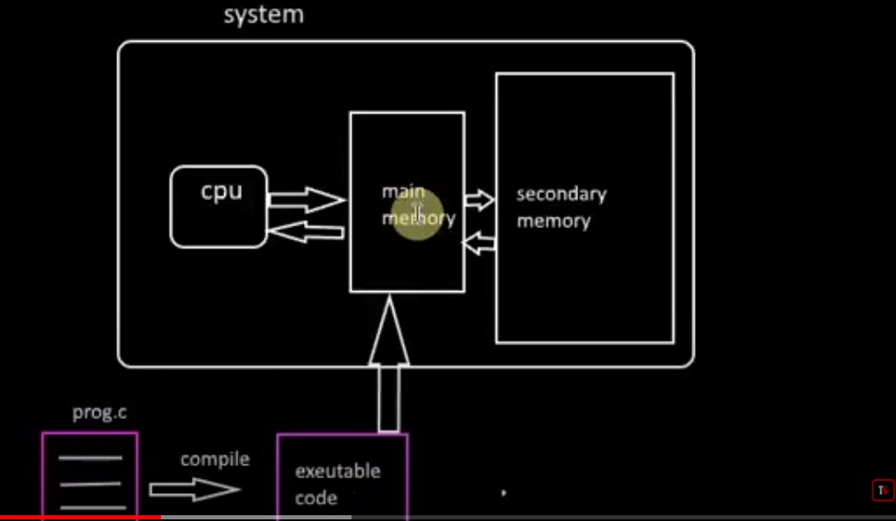
How Memory is Organized
Notes:
Memory Management in Operating System Tutorial-1
https://www.youtube.com/watch?v=392uyAUJqO4

Slide 5
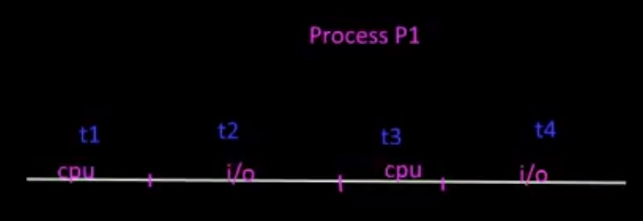
How OS improve the CPU utilization ?

Slide 6
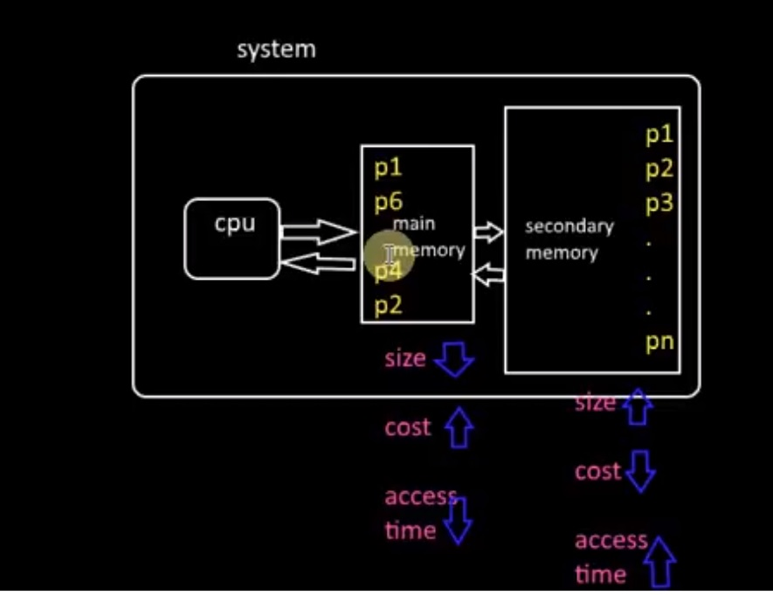
How OS improve the CPU utilization
Notes:
Memory Management in Operating System Tutorial-1
https://www.youtube.com/watch?v=392uyAUJqO4

Slide 7
What is Memory Management¹?
What is Memory Management?
  Memory Management is the process of controlling and coordinating computer memory, assigning portions known as blocks to various running programs to optimize the overall performance of the system.
Goal of Memory Manager
  Manages primary memory
  It helps processes to move back and forward between the main memory and execution disk.
  keep track of every memory location, irrespective of whether it is allocated to some process or it remains free.
  Prevent memory of one process to another process
  Provide isolation between processes
  Divide the RAM in different part
  Space Multiplexing
  Give illusion to process
Notes:
https://www.guru99.com/os-memory-management.html
lec23

Slide 8
Virtual Memory Management
Embedded System and Desktop System
Embedded System or Real time System
  Embedded Process
  Main memory = Total processes
  No concept of VMM
  RAM is divide in different part and every process run in own part
  Single address space –threading
  Multi address space
Desktop System or Server System
Notes:
14.38
https://www.youtube.com/watch?v=o2_iCzS9-ZQ

Slide 9
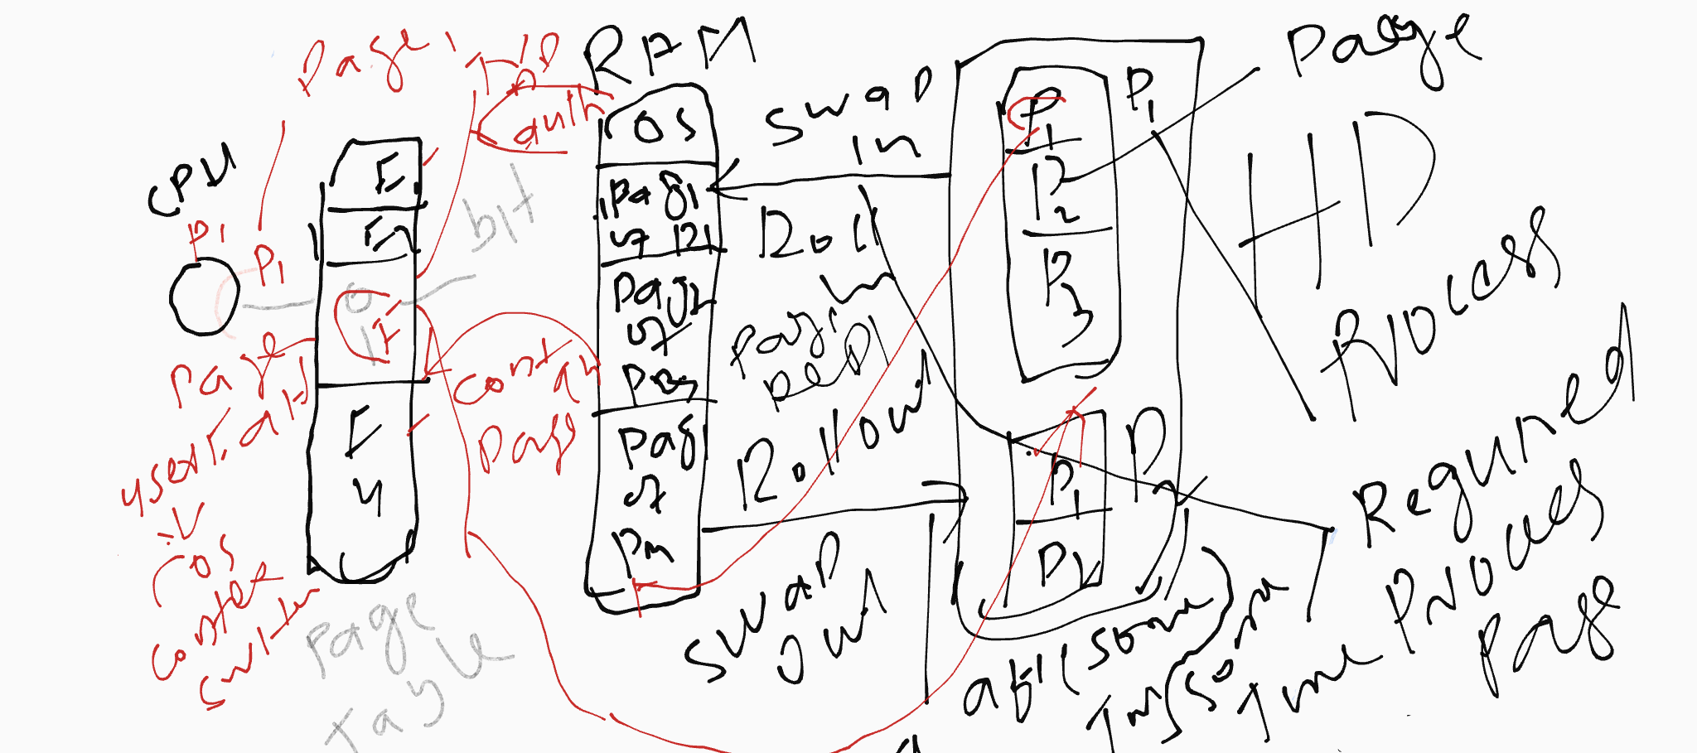
How VM Works
(page fault, page replacing)
Notes:
https://www.youtube.com/watch?v=o2_iCzS9-ZQ

Slide 10
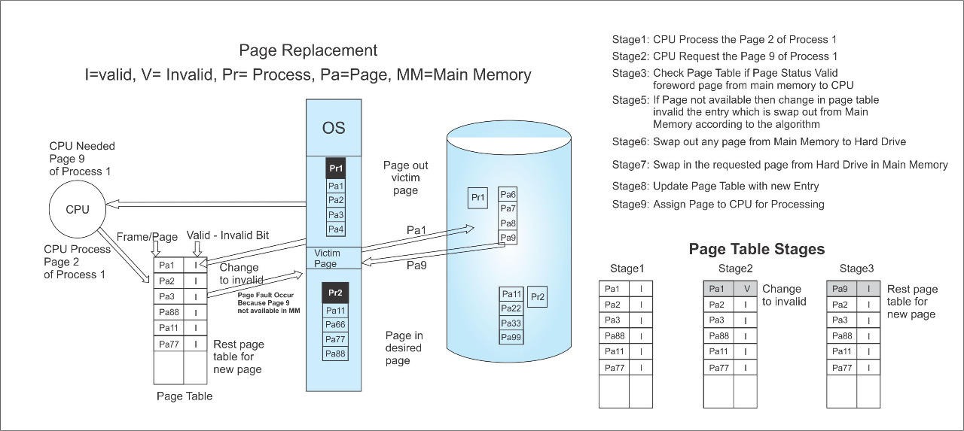
How VM Works

Slide 11
Linker and Loader
Loader is part of OS
How is protection enforced?
  With linker-loader, no protection: one program's bugs can cause other programs to crash
How are processes relocated?
    Virtual address is different from physical address.
Loader
  All the address space pointer ,variable modified those thing and also point the physical location where this program to go
Notes:
Cs703 lec 23 21.38
https://www.careerride.com/os-loader-and-linker.aspx#:~:text=A%20loader%20loads%20the%20programs,a%20program%20if%20written%20separately.
https://www.geeksforgeeks.org/difference-between-linker-and-loader/
https://www.youtube.com/watch?v=vosmW_6MXjM

Slide 12
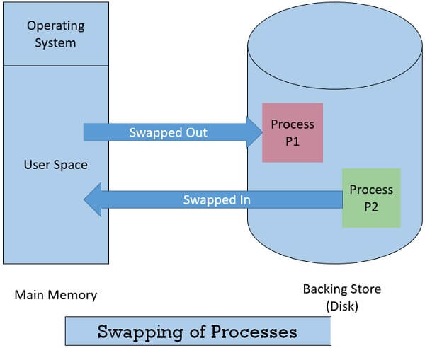
Swapping
save a program‘s entire state (including its memory image) to disk
allows another program to be run
first program can be swapped back in and re-started right where it was
Notes:
CS703 lec23
Swapping is a memory management scheme in which any process can be temporarily swapped from main memory to secondary memory so that the main memory can be made available for other processes. It is used to improve main memory utilization. In secondary memory, the place where the swapped-out process is stored is called swap space.
https://www.javatpoint.com/swapping-in-operating-system
https://binaryterms.com/swapping-in-operating-system.html

Slide 13
Swapping
Time multiplexing
The first timesharing system, MIT‘s ―Compatible Time Sharing System‖ (CTSS), was a uni-programmed swapping system
Problem
  Performance
  We need another technique

Slide 14
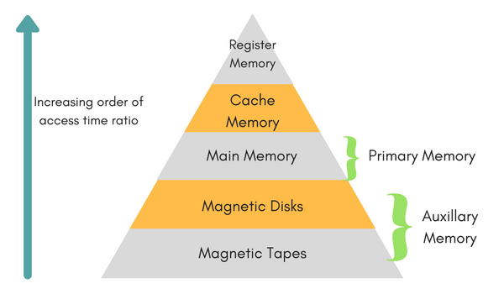
Memory Hierarchy
Notes:
https://www.studytonight.com/computer-architecture/memory-organization#

Slide 15
Memory Hierarchy
Two principles:
  The smaller amount of memory needed, the faster that memory can be accessed.
  The larger amount of memory, the cheaper per byte. Thus, put frequently accessed stuff in small, fast, expensive memory; use large, slow, cheap memory for everything else.
  Register – Internal Memory (CPU) Chips)
    8 Bytes , Direct link to CPU, General purpose register and address related register , 1 FAST access
  Cache Memory – Internal Memory (CPU chips)
    Kilo byte , Static RAM , 2nd fast access
Notes:
Cs703 Lec23 28.15

Slide 16
Memory Hierarchy
RAM
  Dynamic Memory –GB( 8GB etc )
  Provide multiple programming environment
Hard Disk or Magnetic Disk
  TB ( Tara Byte )
  Secondary storage
Magnetic Tap
  PB (petabyte) Stored large amount data
  Offline storage
Notes:
Cs703 Lec23
https://www.youtube.com/watch?v=zwovvWfkuSg

Slide 17
Memory Hierarchy
Temporal locality: will reference same locations as accessed in the recent past
Spatial locality: will reference locations near those accessed in the recent past
Notes:
30.25

Slide 18
References
[1] Memory Management in OS: Contiguous, Swapping, Fragmentation
https://www.guru99.com/os-memory-management.html

