Slide 1
Advance Operating System

Slide 2
Today’s Agenda
Fixed partitions
Variable size Partitioning
How limit register and base register works
Modern Technique: Paging
Address translation
Paging disadvantages
Multi-Level Page Tables

Slide 3
Fixed partitions
It is Virtual memory technique
Contiguous
Physical memory is broken up into fixed partitions
  partitions may have different sizes, but partitioning never changes
Once you assigned program in particular portion
  Protection
      hardware requirement: base register, limit register
      The address is pass through these register for ensure
Notes:
https://www.geeksforgeeks.org/fixed-or-static-partitioning-in-operating-system/
https://www.youtube.com/watch?v=bK-VhQA512c

Slide 4
Fixed partitions
Disadvantages
Disadvantages
  Internal Fragmentation
  Limit in process size
  Degree of multi programming is limited
  External Fragmentation
Advantages
Easy to implement
Notes:
https://www.youtube.com/watch?v=bK-VhQA512c
38.04

Slide 5
How limit register and base register works
Process Generate Virtual address (start 0 with 2k limit)
This address +comparator(offset) and header
Offset compare with 2k limited register
Add in Base registers
  Create actual offset in Main memory
  Main portion address (0- 6k)
Protection fault- validation of limits
Notes:
Lect 703-23-
38.04

Slide 6
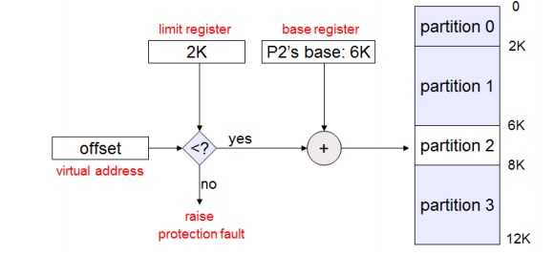
How limit register and base register works

Slide 7
Variable size Partitioning
Contiguous
When process is come to RAM then we allocate the space
There is no chance for internal fragmentation
No limitation on number of processes
No limitation on process size
External Fragmentation
  Compaction - stop processes
Allocation and deallocation
  Complex
hardware requirements: base register, limit register
Notes:
https://www.youtube.com/watch?v=JdPmsrYqRDY

Slide 8
What is Paging | Memory management | Operating System
Page size =Farm size
Process is divide in page and then page is place in frame
Byte-min size
  CPU demand Byte
CPU do not know about Paging when he execute Process P1
  Just asked I need byte no 3 of P1
    Need mapping- Memory Management Unit
    Every process have Page table
        Contain frame number
Notes:
https://www.youtube.com/watch?v=6c-mOFZwP_8&t=60s
Cpu always work on logical address

Slide 9
Modern Technique: Paging
Solve the external fragmentation problem by using fixed sized units in both physical and virtual memory
Virtual address fix portion
  Pages
Physical memory address fix portion
  Page frame –all portion are equal size
Notes:
CS703-23- 44

Slide 10
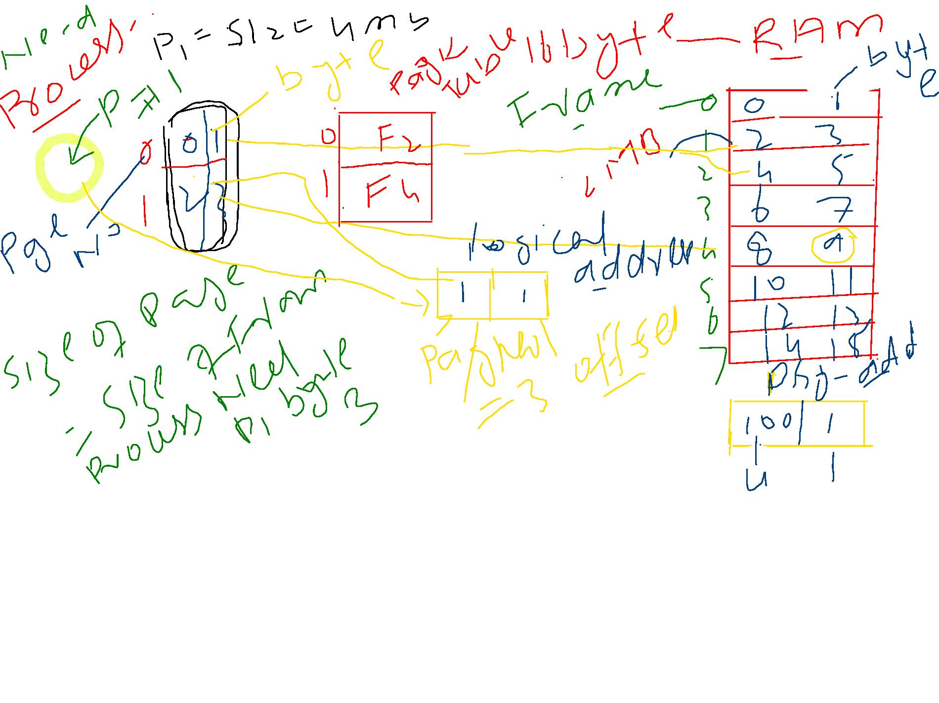
Modern Technique: Paging

Slide 11
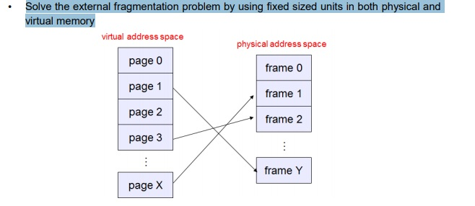
Modern Technique: Paging
Notes:
CS703-23- 44

Slide 12
Address translation
Translating virtual addresses
  a virtual address has two parts: virtual page number & offset
  virtual page number (VPN) is index into a page table
  page table entry contains page frame number (PFN)
  physical address is PFN::offset
Page tables
  managed by the OS
  map virtual page number (VPN) to page frame number (PFN) o VPN is simply an index into the page table
  one page table entry (PTE) per page in virtual address space o i.e., one PTE per VPN
Notes:
CS703-24

Slide 13
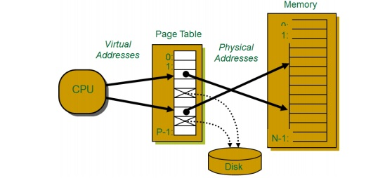
A System with paging based hardware support
Examples: workstations, servers, modern PCs, etc.
Address Translation: Hardware converts virtual addresses to physical addresses via OS managed lookup table (page table)
Notes:
CS703-24-12.44

Slide 14
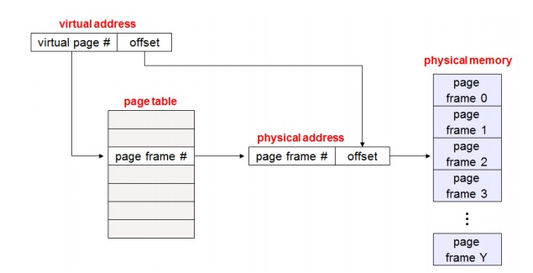
Mechanics of address translation

Slide 15
Paging disadvantages
Can still have internal fragmentation
  process may not use memory in exact multiples of pages
Memory reference overhead
  2 references per address lookup (page table, then memory)
    solution: use a hardware cache to absorb page table lookups
    translation lookaside buffer (TLB) –
Memory required to hold page tables can be large
Notes:
CS703-24-12.44

Slide 16
Page Faults (like “Cache Misses”)
What if an object is on disk rather than in memory?
  Page table entry indicates virtual address not in memory
  OS exception handler invoked to move data from disk into memory
      current process suspends, others can resume
      OS has full control over placement, etc

Slide 17
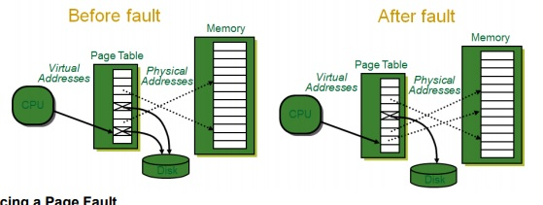
Page Faults (like “Cache Misses”)

Slide 18
Multi-Level Page Tables
Why we divide the single page table in to multi level page table
  If page table size greater then Frame size and then we divide single table into multiple table
Notes:
https://www.youtube.com/watch?v=PiEq1CoP0ds

Slide 19
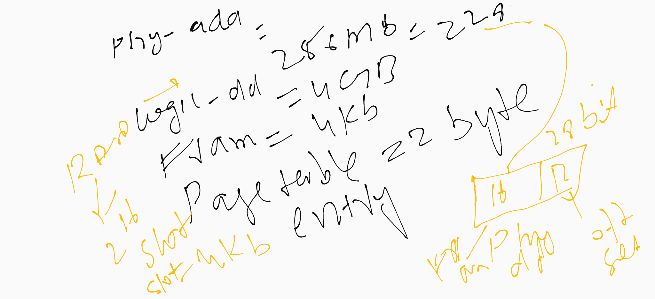
Multi-Level Page Tables

Slide 20
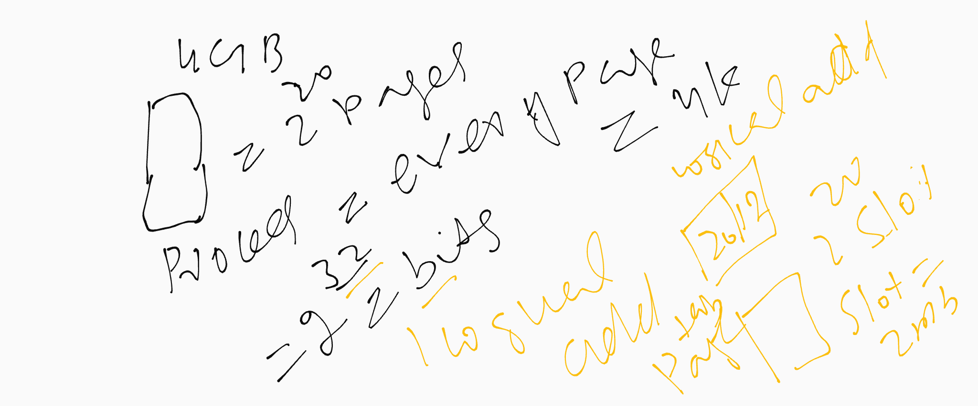
Multi-Level Page Tables

Slide 21
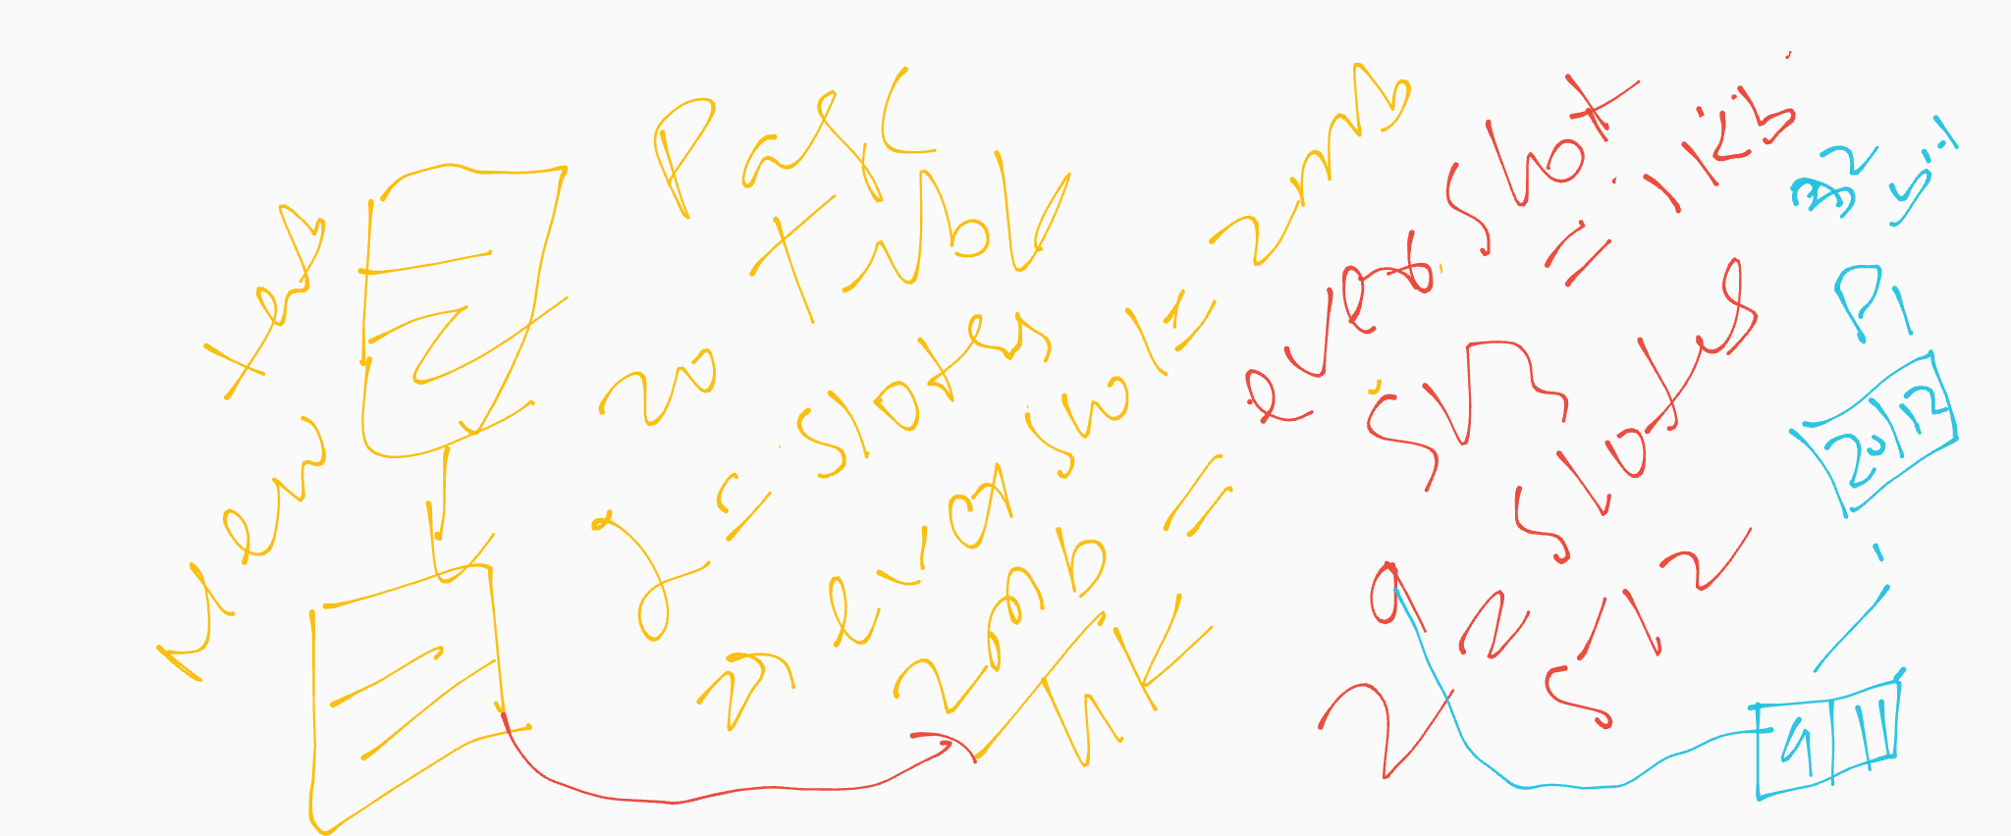
Multi-Level Page Tables

