Slide 1
Advance Operating System

Slide 2
Today’s Agenda
Concurrency, Threading and Parallelism
User Interface
Process Context Switch
Threads
Process Context Switch
Threads Context Switching
User Level thread (ULT)
Kernel Level thread (ULT)
Notes:
Udacity:Lesson 1

Slide 3
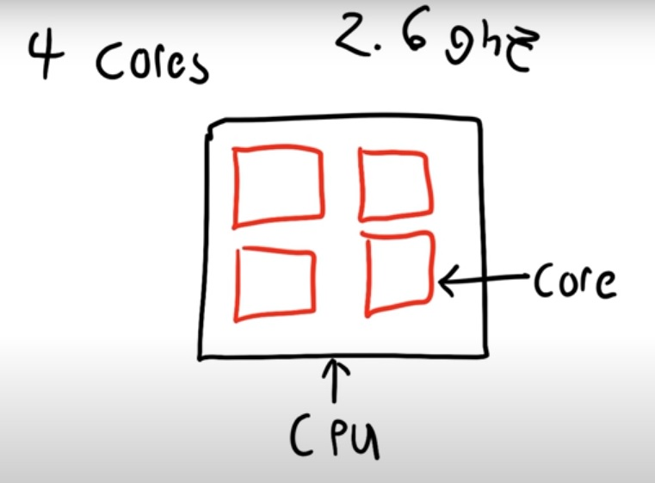
Concurrency, Threading and Parallelism
Parallelism
  If we have multiple things happening at the exact same time
Notes:
https://www.youtube.com/watch?v=olYdb0DdGtM

Slide 4
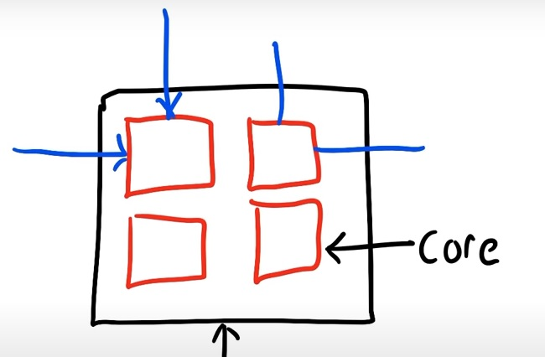
Concurrency, Threading and Parallelism
Threads

Slide 5
User Interface ²
Before threading
  User interface pulse multiple process model are used to achieved Concurrency
Register events plus call back
When single process is going to block it does not block but he schedule events
When events is not expired the process serve next message
Disadvantage
Single process main session state:
Notes:
Lect7

Slide 6
Threads
Process was an executing program with a single thread of control.
Multiple execution state in same address space of single process
On Every network request , create execution stream in same address space
  Maintain own data
Traditional ( heavyweight ) processes have a single thread of control - There is one program counter, and one sequence of instructions that can be carried out at any given time
A thread is a basic unit of CPU utilization, consisting of a program counter, a stack, and a set of registers, ( and a thread ID. )
For example in a word processor, a background thread may check spelling and grammar while a foreground thread processes user input ( keystrokes ), while yet a third thread loads images from the hard drive, and a fourth does periodic automatic backups of the file being edited.
.
Notes:
https://www.cs.uic.edu/~jbell/CourseNotes/OperatingSystems/4_Threads.html#:~:text=A%20thread%20is%20a%20basic,out%20at%20any%20given%20time.

Slide 7
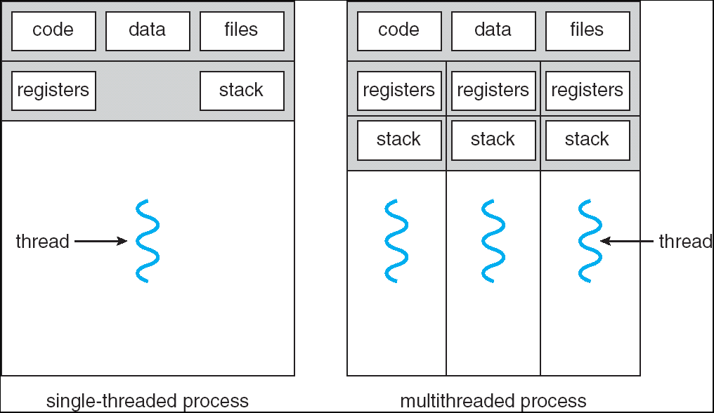
Threads

Slide 8
Process Context Switch
Interrupts cause the operating system to change a CPU from its current task and to run a kernel routing
When an interrupt occurs the system need to save the current context of the process currently running on the CPU so that it can restore that context when its processing is done, essentially suspending. The process and then resuming it
The context is represented in the PCB of the process
Context - process resources
  memory addresses, page tables, and
  kernel resources, caches in the processor.
When does context switching happen?
  high-priority process comes
  Interrupt occurs
  kernel mode switch
Notes:
https://www.geeksforgeeks.org/introduction-of-process-management/
https://www.youtube.com/watch?v=vTgccrbYHYs

Slide 9
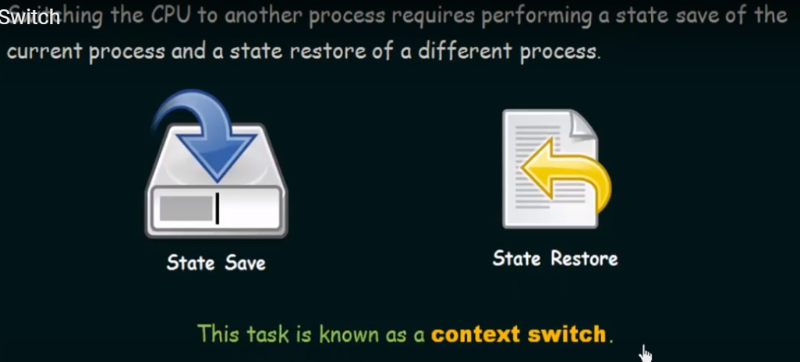
Context Switch

Slide 10
Threads Context Switching
Thread context switch
    Thread switching is a type of context switching from one thread to another thread in the same process.
During Thread Context switch
    Saved the Program counter –CPU register- Stack Counter values
    Push machine state on other threads
Thread switching is very efficient and much cheaper
  Program counter, registers and stack pointers.
  Context switching in same address space
Setjmp and longjmp- System call in C
  Context swtiching user level thread
Notes:
Thread switching :
Thread switching is a type of context switching from one thread to another thread in the same process. Thread switching is very efficient and much cheaper because it involves switching out only identities and resources such as the program counter, registers and stack pointers.
https://www.geeksforgeeks.org/difference-between-thread-context-switch-and-process-context-switch/
Context swtich
The process of saving the context of one process and loading the context of another process is known as Context Switching. In simple terms, it is like loading and unloading the process from running state to ready state.
https://www.geeksforgeeks.org/introduction-of-process-management/

Slide 11
User Level thread (ULT)
User level threads are manage by user level library
it is the responsibility of application to create user level threads through procedure call
P thread-library to create thread
Easy and take less time
User level thread are fast
Context switching is faster
if one user level threads perform blocking operating then entire process get block
Notes:
https://www.geeksforgeeks.org/threads-and-its-types-in-operating-system/

Slide 12
Kernel Level thread (ULT)
kernel level threads are manage by OS
  system Call
  Greater time
Slow
Its creation is similar to create process
Context switching is slow
IF ONE Kernal level thread block , no affacts on oterh
Notes:
https://www.youtube.com/watch?v=-NONm-Jq34Y
Lec7:0.41

