Slide 1
Rules for Differentiation

Slide 2
Objective
Why derivative rules?
To differentiate functions using the
  power rule
  constant rule
  constant multiple rule
  sum and difference rules.

Slide 3
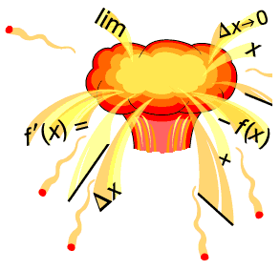
Why derivative rules?
Taking the derivative by using the definition is a lot of work.
Perhaps there is an easy way to find the derivative

Slide 4
The Derivative is …
Used to find the “slope” of a function at a point.
Used to find the “slope of the tangent line” to the graph of a function at a point.
Used to find the “instantaneous rate of change” of a function at a point.

Slide 5
Notations for the
Derivative of a Function
“f prime of x”
“y prime”
“the derivative of y with respect to x”

Slide 6

The Power Rule

Slide 7
example
Differentiate:

Slide 8
The Constant Rule
The derivative of a constant function is zero.

Slide 9
Example
Find the derivative of:

Slide 10
The Constant Multiple Rule
The derivative of a constant times a function is equal to the constant times the derivative of the function.

Slide 11
Example 1
Find the derivative of:

Slide 12
Example 2
Find the derivative of:

Slide 13
EXAMPLE 3
Find the derivative of:

Slide 14
The Sum and Difference Rules
The derivative of a sum is the sum of the derivatives.
The derivative of a difference is the difference of the derivatives.

Slide 15
eXAMPLE
Differentiate:

