Slide 1
Advance Operating System

Slide 2
Today’s Agenda
Suspending Processes (7-State Model)
Unix SVR4 processes
Modes of Execution
System Call P
System Program
Process Control Block (PCB)
PCB- Memory Table
PCB- IO tables
PCB- File table
Fork: Creating new processes
Fork: With the example
Notes:
Udacity:Lesson 1

Slide 3
Lesson Objective
By the end of lesson:
  Ready to discussed about PCB
  Understand the System Call
  Unix SVR4 Processes²
  Modes of Execution
  Operating System Control Structures ²
  Memory table

Slide 4
Suspending Processes
(7 state model)
Ready Queue
  It contain Data structure( Process control block) pointer
We need additional state – 7 State model
After admission , some time process go to long waiting state for some events
  We need swap to disk ( Printer)
      Save in specific place on HD
  It is called suspend
Notes:
When there is lot of job waiting for printer
CS703-lec5-25:24

Slide 5
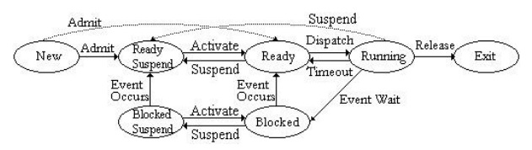
Suspending Processes
(7 state model)
Key States:
    Ready – In memory, ready to execute
    Blocked – In memory, waiting for an event Blocked Suspend – On disk, waiting for an event
    Ready Suspend – On disk, ready to execute

Slide 6
Suspending Processes ²
Suspend in ready state
  Dispatcher will decided that the process halt the CPU more
  Reside on disk
Suspend in block state
  Save in disk
Other state are in memory

Slide 7
Unix SVR4 Processes²
Uses 9 processes states
Process part of Unix
Kernel running
  Process is running inside kernel
Zombie: exit state
Preempted state
  When some work is interrupt
  During this system call finished
Notes:
Lec5
User running call system call and come to kernel running

Slide 8
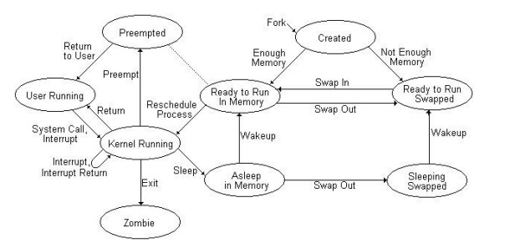
Unix SVR4 Processes²
Notes:
lec5

Slide 9
Modes of Execution ²
User mode
  Less-privileged mode
  User programs typically execute in this mode
System mode, control mode, or kernel mode
  More-privileged mode
  Kernel of the operating system
Privileged mode
  There is some extraction in OS which only access in specific mode
  CPU set some flag – interrupt handler
  System call
Notes:
There is some extraction in OS or there is some memory location which only access in specific mode
https://www.geeksforgeeks.org/dual-mode-operations-os/
https://www.geeksforgeeks.org/user-mode-and-kernel-mode-switching/

Slide 10
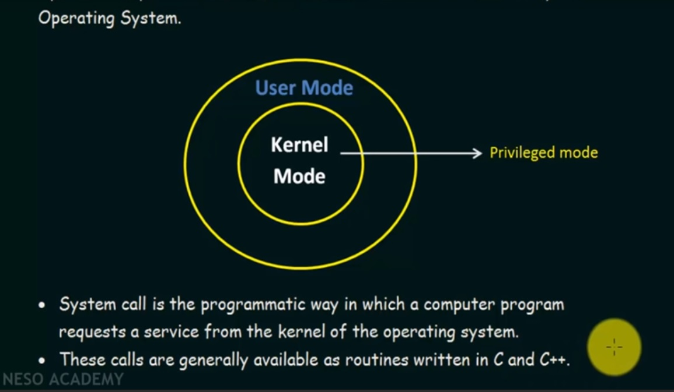
System Call
System call provide interface to the services made available by OS
Notes:
https://www.youtube.com/watch?v=lhToWeuWWfw&list=PLBlnK6fEyqRiVhbXDGLXDk_OQAeuVcp2O&index=9

Slide 11
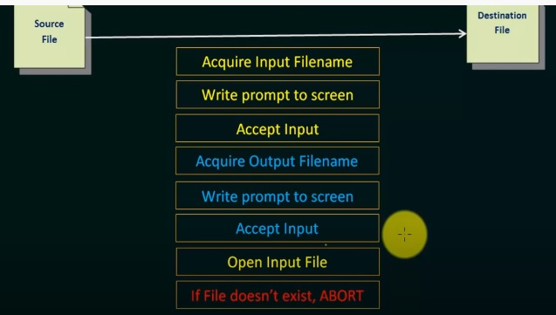
System Call

Slide 12
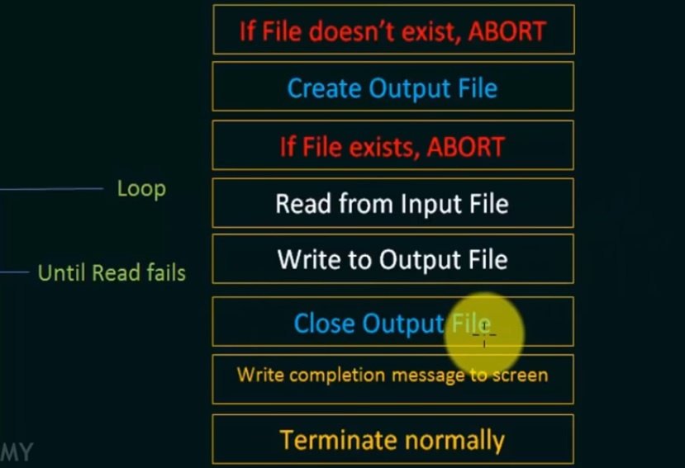
System Call

Slide 13
System Program
The system programs are used to program the operating system software. While application programs provide software that is used directly by the user, system programs provide software that are used by other systems such

Slide 14
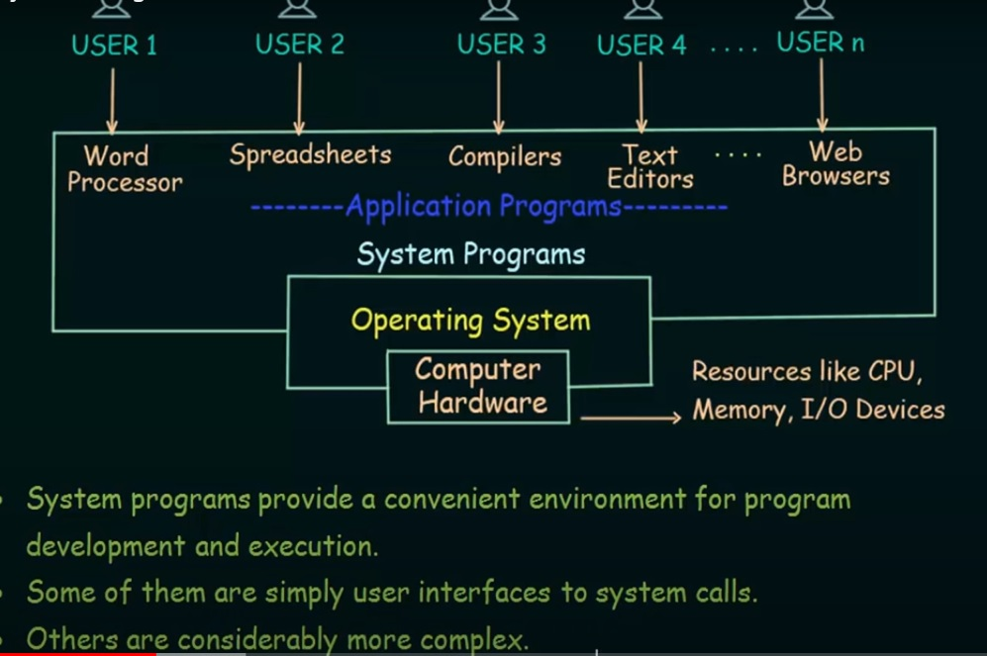
System Program
Notes:
https://www.youtube.com/watch?v=UWDzhz8MVqc&list=PLBlnK6fEyqRiVhbXDGLXDk_OQAeuVcp2O&index=11

Slide 15
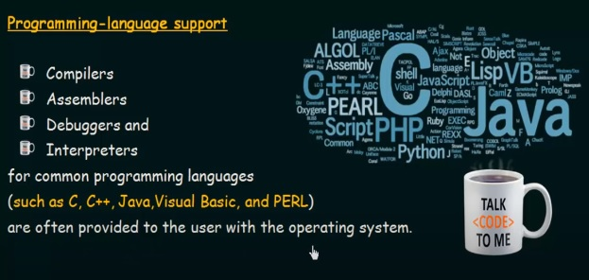
System Program

Slide 16

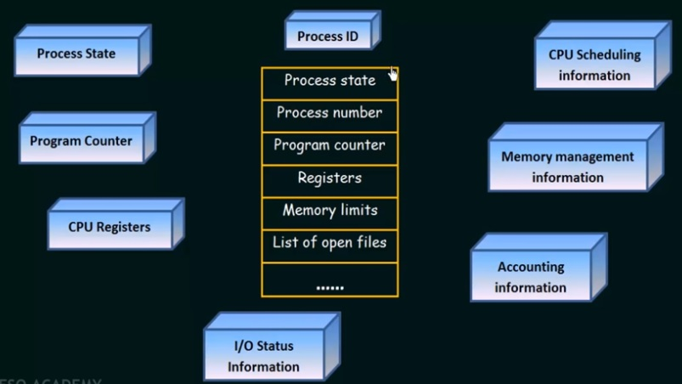
Process Control Block
(PCB)
Notes:
https://youtu.be/4s2MKuVYKV8

Slide 17
Process Control Block
(PCB)
Part of information contain in Process control block (PCB) and it is divide in two class
  Information which define CPU context(CPU )
    Register , stack pointer , program counter , memory table . i/o tables
  Information which define general system context
  Program counter contain the address of next instruction that execute next

Slide 18
Memory table
Allocation of main memory to processes
Allocation of secondary memory to processes
Protection attributes for access to shared memory regions
Information needed to manage virtual memory

Slide 19
I/O tables
I/O device is available or assigned
Status of I/O operation
Location in main memory being used as the source or destination of the I/O transfer

Slide 20
File table
Which files is opens
Existence of file is open
Location on secondary memory
Current state
Attribute
Location on secondary memory
Current Status
Sometimes this information is maintained by a file management system

Slide 21
Process Control Block
Process identification
  Identifiers
    Numeric identifiers that may be stored with the process control block include Identifier of this process
      Identifier of the process that created this process (parent process)
      User identifier
Process Control Information
Scheduling and State Information
    This is information that is needed by the operating system to perform its scheduling function. Typical items of information:
    Process state: defines the readiness of the process to be scheduled for execution (e.g., running, ready, waiting, halted).
    Priority: One or more fields may be used to describe the scheduling priority of the process. In some systems, several values are required (e.g., default, current, highest-allowable)
    Priority may be assigned by user
    Scheduling-related information: This will depend on the scheduling algorithm used. Examples are the amount of time that the process has been waiting and the amount of time that the process executed the last time it was running.
    Event: Identity of event the process is waiting before it can be resume
    Who is the user and owner

Slide 22
Process Control Block²
Inter-process Communication
  Various flags, signals, and messages may be associated with communication between two independent processes. Some or all of this information may be maintained in the process control block
  If there any mechanism used for inter-process
Process Privileges
  Processes are granted privileges in terms of the memory that may be accessed and the types of instructions that may be executed. In addition, privileges may apply to the use of system utilities and services.

Slide 23
Process Termination
Normal exit (voluntary).
2. Error exit (voluntary).
3. Fatal error (involuntary)-Divide by zero
4. Killed by another process (involuntary).
  Process executes a system call telling the operating system to kill some other process

Slide 24
fork: Creating new processes
How process is create in Linux
There child and parent relationship between process
In window there is no such relation ship and there is only pair relationship and it used win32 function call
int fork(void)
  creates a new process (child process) that is identical to the calling process (parent process)
  returns 0 to the child process
  returns child‘s pid to the parent process

Slide 25
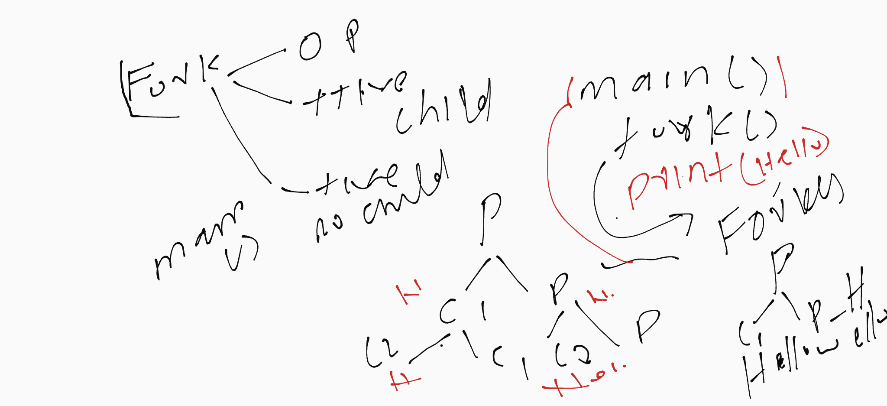
Fork with example
Notes:
https://www.youtube.com/watch?v=ixq5cpdEO2Q&ab_channel=GateSmashers

Slide 26
fork: Creating new processes
Logical steps
  First we create address space
  And then excitable load in this space
In Linux we can only create address space and it will be the copy of parent.
The childe start execution where parent create this child
This is called fork system call

Slide 27
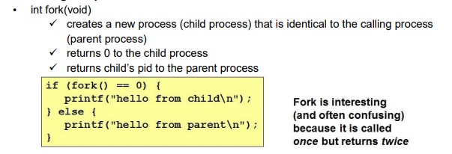
fork: Creating new processes
Notes:
Helow from child is print in child not parent

Slide 28
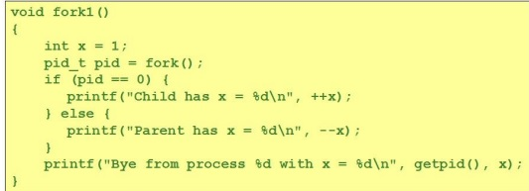
Fork Example #1
Key Points
  Parent and child both run same code
    Distinguish parent from child by return value from fork
Notes:
For example there is one screen and who will print on screen first

Slide 29
Fork Example #2
Key Points
  Both parent and child can continue forking

Slide 30
References
[1] CS703 Advanced Operating System
https://www.youtube.com/watch?v=ADd4VQ6_owI&list=PL9A3A425C6124EEDA
[2] Advanced Operating System
https://classroom.udacity.com/courses/ud189/lessons/3652509443/concepts/6416592080923
[3] Operating System Concepts, 7th Edition
Cho1:http://bcs.wiley.com/he-bcs/Books?action=resource&bcsId=2217&itemId=0471694665&resourceId=5004
[4] Advanced Operating System
https://ocw.vu.edu.pk/Videos.aspx?cat=Computer+Science%2fInformation+Technology+&course=CS703

Slide 31
References
[5] Operating System
https://www.personal.kent.edu/~rmuhamma/OpSystems/Myos/sysComponent.htm
[6] http://faculty.salina.k-state.edu/tim/ossg/Introduction/struct.html
[7] Modern Operating System

