Slide 1
Advance Operating System

Slide 2
Today’s Agenda
Process definition
Multiprogramming and Multitasking Operating System
Multiprogramming System
Multiprocessor systems
Private Address Spaces
Control Flow
Altering the Control Flow (synchronous)
Altering the Control Flow (asynchronous) or Exceptional Control Flow
Exceptional Control flow
Interrupt P1
Interrupt P2
Traps
Fault
aborts
Trap Example
Fault Example
Notes:
Udacity:Lesson 1

Slide 3
Today’s Agenda
Change of Process State

Slide 4
Lesson Objective
By the end of lesson:
  Ready to discussed about process
  Understand the Control flow and interrupts

Slide 5
Process definition²
A program in execution
An instance of a program running on a computer
The entity that can be assigned to and executed on a processor •
A unit of activity characterized by the execution of a sequence of instructions, a current state, and an associated set of system instructions
Notes:
lec4

Slide 6
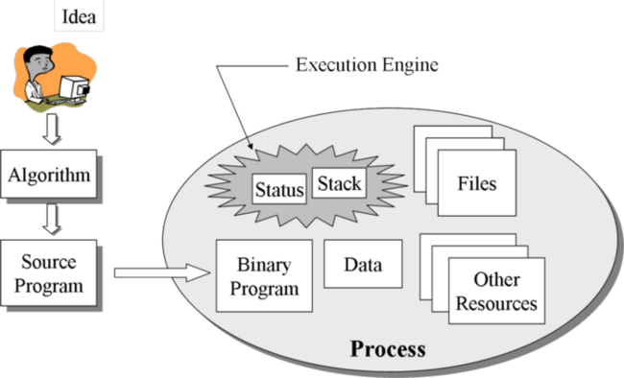
Process definition⁶
Notes:
http://faculty.salina.k-state.edu/tim/ossg/Process/p_contents.html

Slide 7
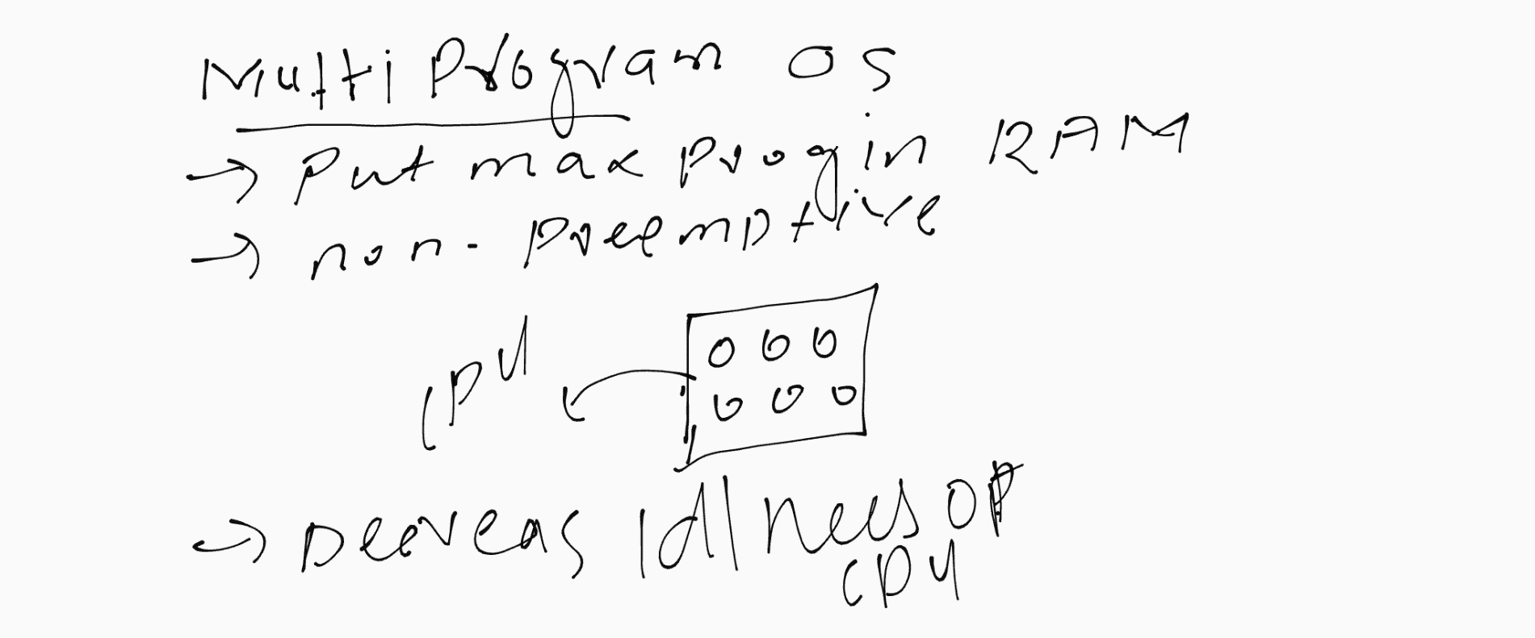
Multiprogramming and
Multitasking Operating System
Notes:
https://www.youtube.com/watch?v=3MqyDWDpZoI&ab_channel=GateSmashers

Slide 8
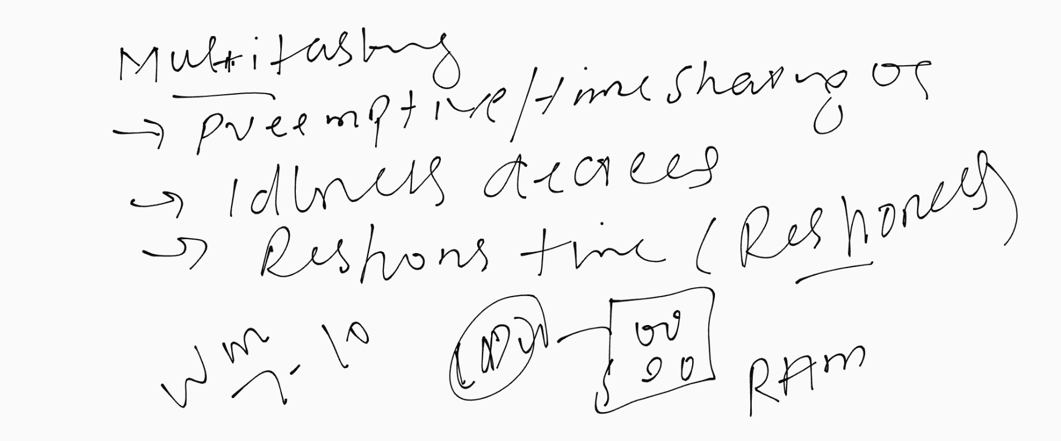
Multiprogramming and
Multitasking Operating System
Notes:
https://www.youtube.com/watch?v=3MqyDWDpZoI&ab_channel=GateSmashers

Slide 9
Multiprogramming system
In any multiprogramming system, the CPU switches from process to process quickly, running each for tens or hundreds of milliseconds.
Multiprogramming is also the ability of an operating system to execute more than one program on a single processor machine. More than one task/program/job/process can reside into the main memory at one point of time. A computer running excel and firefox browser simultaneously is an example of multiprogramming.
Notes:
https://www.thecrazyprogrammer.com/2014/12/difference-between-multiprogramming-multitasking-multiprocessing-multithreading.html#:~:text=Multiprogramming%20is%20also%20the%20ability,is%20an%20example%20of%20multiprogramming.

Slide 10
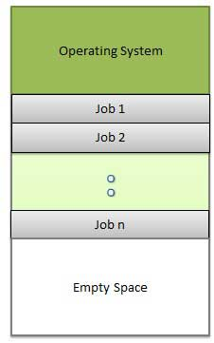
Multiprogramming system
Notes:
https://www.thecrazyprogrammer.com/2014/12/difference-between-multiprogramming-multitasking-multiprocessing-multithreading.html#:~:text=Multiprogramming%20is%20also%20the%20ability,is%20an%20example%20of%20multiprogramming.

Slide 11
Multiprocessor systems
Multiprocessor systems
  which have two or more CPUs sharing the same physical memory
Multiprocessing is the ability of an operating system to execute more than one process simultaneously on a multi processor machine. In this, a computer uses more than one CPU at a time.
Notes:
https://www.thecrazyprogrammer.com/2014/12/difference-between-multiprogramming-multitasking-multiprocessing-multithreading.html#:~:text=Multiprogramming%20is%20also%20the%20ability,is%20an%20example%20of%20multiprogramming.

Slide 12
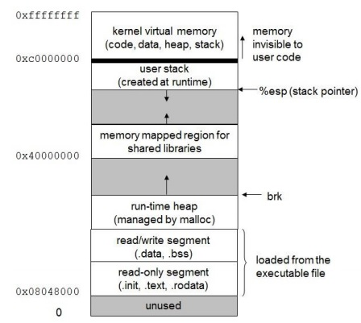
Private Address Spaces ²
Each process has its own private address space.
Notes:
Lec4
Spaces: variable take range of value
The possible address range in one program which touch this program or memory address that touch by one program
CPU generate address- Code address + Data Address
32 bit CPU generate ff range Adress

Slide 13
Private Address Spaces ²
Run-time heap
  Some program need run time memory
User stack
  It create
    Program call function call, variable
  All these variable and function call address stored in stack
  Increased and decreased
Memory map
  During run time when shared library link dynamically
Kernel
  How to enter OS code into process
  How to make kernel as port of process
Notes:
The order may be LIFO(Last In First Out) or FILO(First In Last Out).

Slide 14
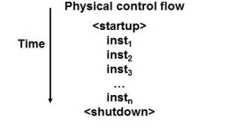
Control Flow ²
Computers do Only One Thing
  From startup to shutdown, a CPU simply reads and executes (interprets) a sequence of instructions, one at a time.
This sequence is the system‘s physical control flow (or flow of control).
Notes:
CS703_Lecture04

Slide 15
Altering the
Control Flow (synchronous)
  How to enter OS code into process
  Two basic mechanisms available to the programmer for changing control flow:
    Jumps and branches ( if then)
    Function call and return using the stack discipline.
    Both react to changes in program state.
interrupts are produced by the CPU control unit while executing instructions and are called synchronous because the control unit issues them only after terminating the execution of an instruction.
Notes:
Lec4
Program jump on function call address and push the function return address
ASYNRHRONIES , the events who force the program to enter into OS

Slide 16
Altering the
Control Flow (asynchronous)
First two method is not enough we need asynchronous method
  Create events that Force the CPU to execute the instruction
    Instruction divides by zero ( Faulty instruction)
    User hits ctl-c at the keyboard ( user stop flow)
    System timer expires (complete Disk IO)
This is also called exception control flow

Slide 17
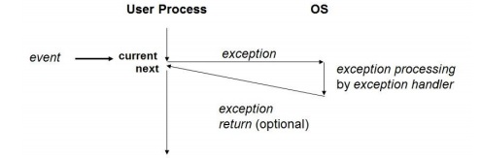
Exceptions²
An exception is a transfer of control to the OS in response to some event (i.e., change in processor state)
Notes:
lec4

Slide 18
Asynchronous Exceptions (Interrupts) ²
Caused by events external to the processor
  Indicated by setting the processor‘s interrupt pin
  handler returns to ―next‖ instruction.
Examples:
  I/O interrupts
    hitting ctl-c at the keyboard
    arrival of a packet from a network
    arrival of a data sector from a disk
  Hard reset interrupt
    hitting the reset button
  Soft reset interrupt
      hitting ctl-alt-delete on a PC
Notes:
Lec4

Slide 19
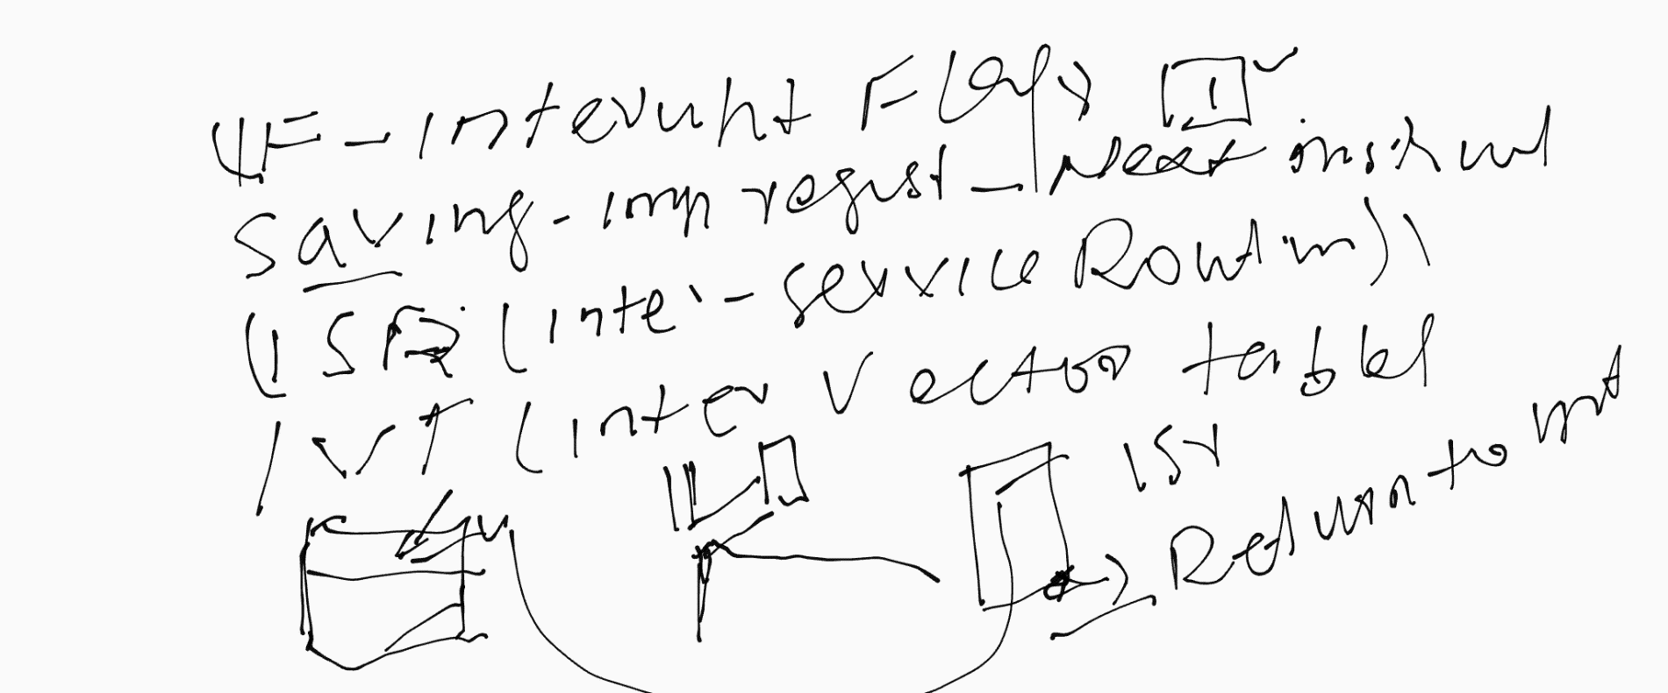
Interrupts

Slide 20
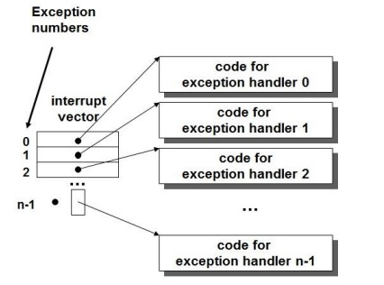
Interrupt Vectors²
During Interrupt , CPU jump on pre determined location and these pre-determined location is called vector
Interrupt handler is part of OS code
Notes:
Lec4
Interrupt Vector is array and it contains function pointer or these are addresses of function and these interrupt handler is part of OS system code

Slide 21
^{Traps}
Synchronous Exceptions
Caused by events that occur as a result of executing an instruction:
  Traps
    unintentional
    It is user define interrupts
    Run some code in program and this code alter the CPU system call and this system call execute hardware handler
    Examples: system calls, breakpoint traps, special instructions
    Returns control to ―next‖ instruction
  Faults
    Unintentional but possibly recoverable
    Examples: page faults (recoverable), protection faults (unrecoverable).
    Either re-executes faulting (―current‖) instruction or aborts
Notes:
Synchronous – User manually do this, Enter something in program through which it enter to CPU

Slide 22
Synchronous Exceptions ²
Aborts
  unintentional and unrecoverable
  Examples: parity error, machine check. o Aborts current program
  Alt F4 to abort program that stop responding
Notes:
https://www.computerhope.com/jargon/a/abort.htm

Slide 23
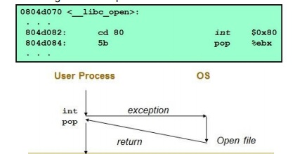
Trap Example
Opening a File
  User calls open(filename, options)
  Function open executes system call instruction int
  OS must find or create file, get it ready for reading or writing
  Returns integer file descriptor
Notes:
In Case trap , it return to next instruction

Slide 24
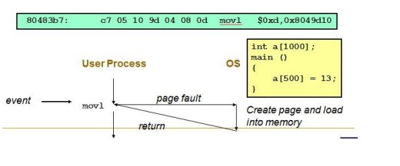
Fault Example # 1
Memory Reference
    User writes to memory location
    That portion (page) of user‘s memory is not currently on disk
    Page handler must load page into physical memory
    Returns to faulting instruction
    Successful on second try
Notes:
In case fault it return same instruction so that it execute this instruction again

Slide 25
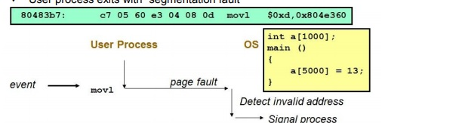
Fault Example # 2
Memory Reference
  User writes to memory location
  Address is not valid
  Page handler detects invalid address
  Sends SIGSEG signal to user process
  User process exits with ―segmentation fault‖

Slide 26
References
[1] CS703 Advanced Operating System
https://www.youtube.com/watch?v=ADd4VQ6_owI&list=PL9A3A425C6124EEDA
[2] Advanced Operating System
https://classroom.udacity.com/courses/ud189/lessons/3652509443/concepts/6416592080923
[3] Operating System Concepts, 7th Edition
Cho1:http://bcs.wiley.com/he-bcs/Books?action=resource&bcsId=2217&itemId=0471694665&resourceId=5004
[4] Advanced Operating System
https://ocw.vu.edu.pk/Videos.aspx?cat=Computer+Science%2fInformation+Technology+&course=CS703

Slide 27
References
[5] Operating System
https://www.personal.kent.edu/~rmuhamma/OpSystems/Myos/sysComponent.htm
[6] http://faculty.salina.k-state.edu/tim/ossg/Introduction/struct.html
[7] Modern Operating System

