Slide 1
Advance Operating System
Notes: Some Slides and Picture are follow from different courses and Books

Slide 2
Today’s Agenda
What is process Address Space?
Example-Covert any C program into process Part
COFF File Format
ELF Objects File Format P1
Example of C P1( C program details)
Strong and Weak Symbols
Linker’s Symbol Rules
Notes:
Udacity:Lesson 1

Slide 3
Lesson Objective
By the end of lesson:
  Ready to discussed address space of OS
  Understand the Strong and Weak Symbols
  Understand the address space creation steps

Slide 4
What is Process Address Space?
Address space is a space in computer memory. And process Address Space means a space that is allocated in memory for a process. Every process has an address space
Types
  Physical Address Space
  Virtual Address Space
Notes:
https://t4tutorials.com/process-address-space-in-operating-systems/
https://www.youtube.com/watch?v=f7uRuisAjVY&ab_channel=T4Tutorials

Slide 5
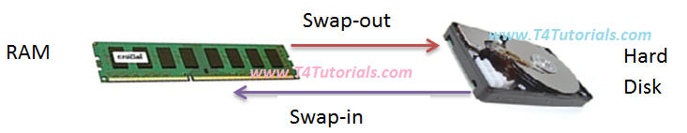
What is Process Address Space?
Notes:
https://t4tutorials.com/process-address-space-in-operating-systems/
https://www.youtube.com/watch?v=f7uRuisAjVY&ab_channel=T4Tutorials

Slide 6
Example:
Covert any C program into process
Range of address which define their memory
When process is load then OS create address space
Formatting of any object file or programme to a process involves two steps
  1) linking and becoming an executable file
  2) executable file to process or address space
Notes:
When process is load then OS create address space
Covert any C program into process need two steps
Re-locatable object or Lin linux .o or .obj: They do not have link and it has re-locatable address or change address
executable file: when find all the link and they have own change address
Another chain address come when program load in main memory and they different from executable and object addressess
Details
Object file
Exe file
Full shared files
File format: header plus file
OS define format

Slide 7
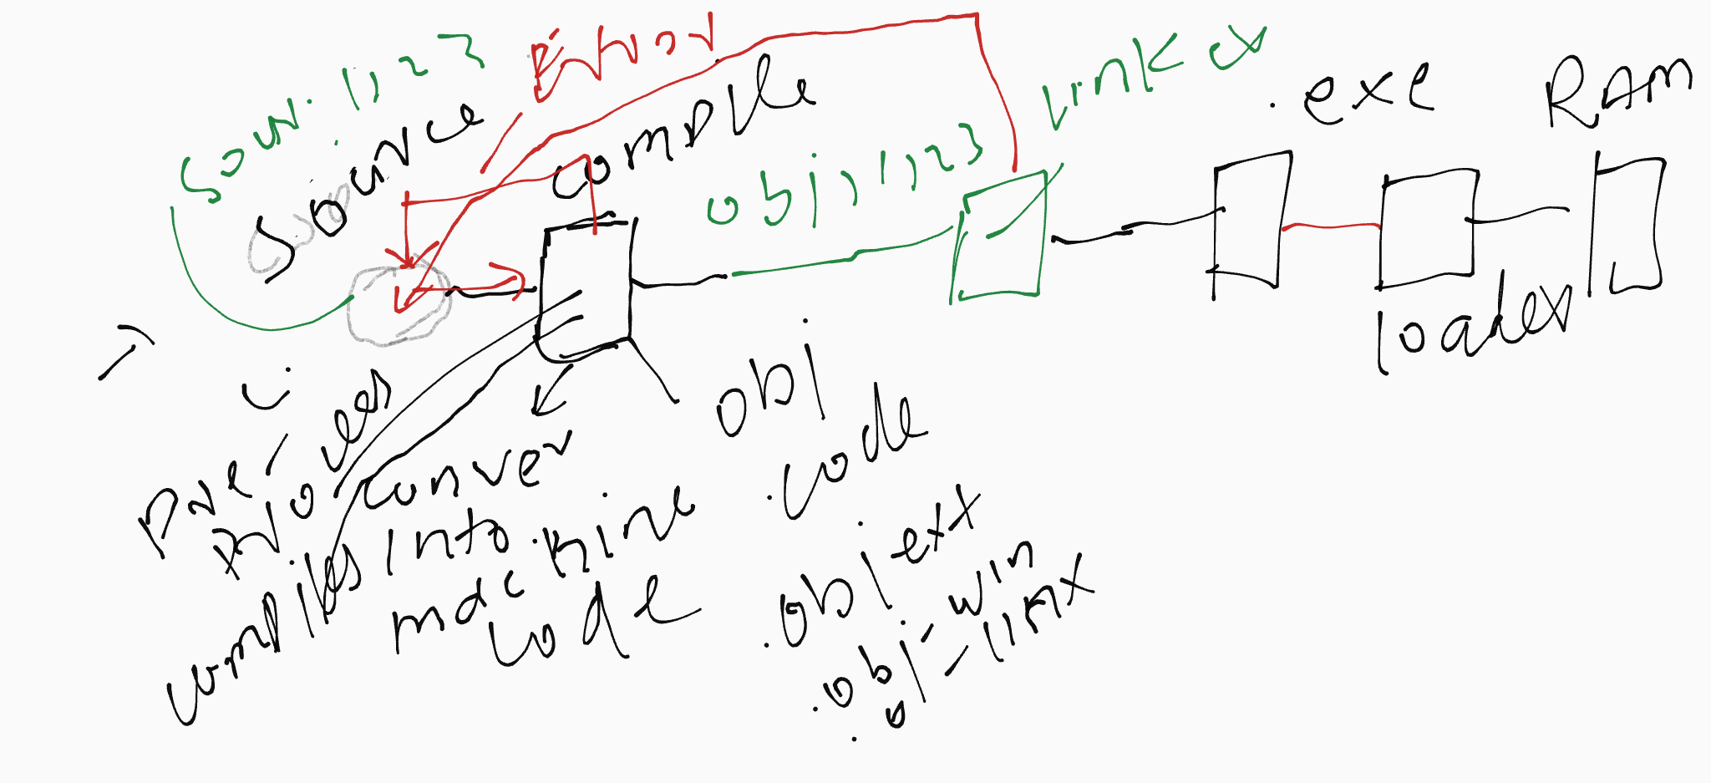
Example:
Covert any C program into process

Slide 8
Type of Files
3 Type of objects Files
  Re-locatable file or object files or .o files
  Fully linked or executable files
  Shared object files or Linux .SO
All these files need format which define by os
  Header: where code start and end
  Data:
  Other section

Slide 9
COFF File Format
Common Objects File Format (COFF)
  Used in Linux
  .exe is variation of COFF or portal executable
  Less used in Unix

Slide 10
ELF Objects File Format
Executable and Linkable
Common in Linux and Unix
Define common format for three object type ( .o, .exe, common share)
Easy to manage the file
Header:
.text section
  Code of C++ Program , binary form
.data section
  Initialized (static) data- variable range which initialized during programming
.bss section
  Uninitialized (static) data
  ―Block Started by Symbol‖
  ―Better Save Space‖
  Has section header but occupies no space
symtab section
  Symbol table
  Procedure and static variable names
  Section names and locations

Slide 11
ELF Objects File Format
.rel.text section
  Relocation info for .text section
  Addresses of instructions that will need to be modified in the executable
  Instructions for modifying. Function
.rel.data section –global variable
  Relocation info for .data section
  Addresses of pointer data that will need to be modified in the merged executable- global variable
debug section
  Info for symbolic debugging (gcc -g)

Slide 12
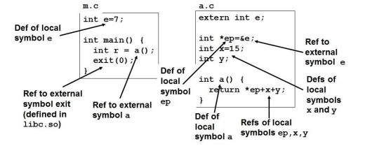
Example of C
.
Notes:
https://www.youtube.com/watch?v=OjxYdLUw_p0&list=PL9A3A425C6124EEDA&index=3&ab_channel=vu

Slide 13
Symbols and References
Symbols are lexical entities that name functions and variables.
Each symbol has a value (typically a memory address).
Code consists of symbol definitions and references.
• References can be either local or external.

Slide 14
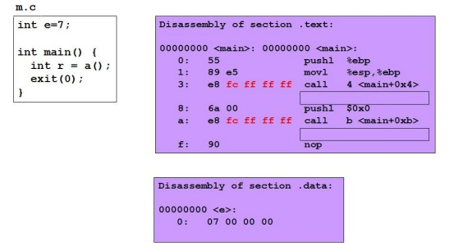
m.o Relocation Info

Slide 15
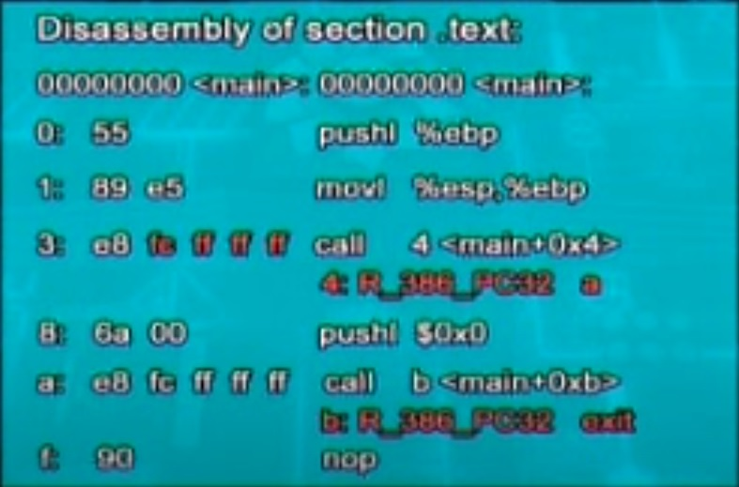

Slide 16
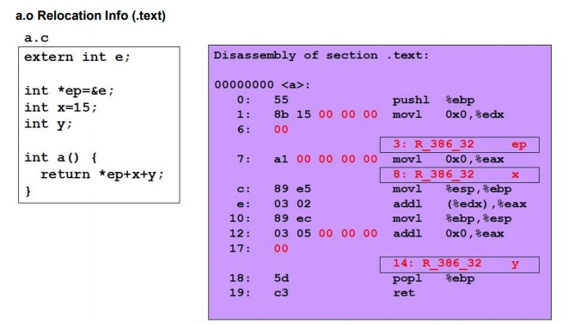
m.o Relocation Info

Slide 17
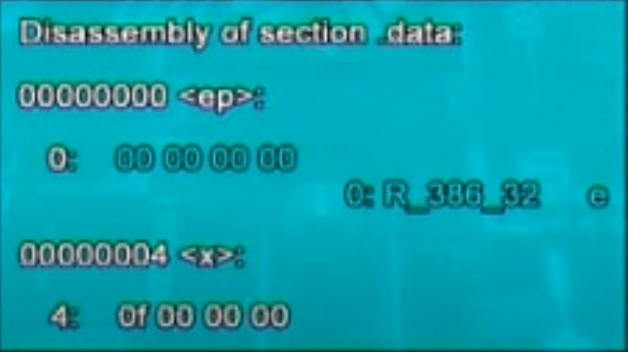

Slide 18
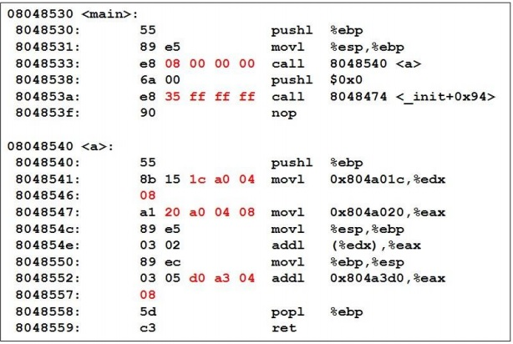
Executable after Relocation and External Reference Resolution (.text)

Slide 19
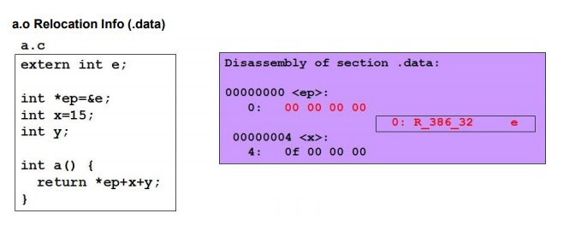

Slide 20
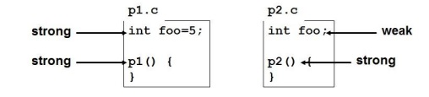
Strong and Weak Symbols
Program symbols are either strong or weak
  Strong: procedures and initialized global
  weak: uninitialized global

Slide 21
Linker’s Symbol Rules
Rule 1. A strong symbol can only appear once. •
Rule 2. A weak symbol can be overridden by a strong symbol of the same name. ✓ References to the weak symbols resolve to the strong symbol.
Rule 3. If there are multiple weak symbols, the linker can pick an arbitrary one.

Slide 22
References
[1] CS703 Advanced Operating System
https://www.youtube.com/watch?v=ADd4VQ6_owI&list=PL9A3A425C6124EEDA
[2] Advanced Operating System
https://classroom.udacity.com/courses/ud189/lessons/3652509443/concepts/6416592080923
[3] Operating System Concepts, 7th Edition
Cho1:http://bcs.wiley.com/he-bcs/Books?action=resource&bcsId=2217&itemId=0471694665&resourceId=5004
[4] Advanced Operating System
https://ocw.vu.edu.pk/Videos.aspx?cat=Computer+Science%2fInformation+Technology+&course=CS703

Slide 23
References
[5] Operating System
http://faculty.salina.k-state.edu/tim/ossg/Introduction/struct.html
[6] http://faculty.salina.k-state.edu/tim/ossg/Introduction/struct.html

