Slide 1
Advance Operating System

Slide 2
Question?
How it possible for single device to do all things( Watching video, Browsing etc)
  Do that at same time
Diverse application written by different programmer.
Who is the in-charge of this ?
  Operating System?
Notes:
Udacity:Lesson 1

Slide 3
Today’s Agenda
Computer System Structure
The layers Structure
What is an os
Simple Example- Display Screen
Simple Example- Abstraction
Simple Example- Resource Manager
The Major issues of OS4
Type of Operating Systems4
Notes:
Udacity:Lesson 1

Slide 4
Lesson Objective
By the end of lesson:
  Ready to discussed basic of OS
  Understand the purpose of the operating system
  Provide information about types OS and design issue

Slide 5
Questions
Which of the following is an operating System(os)?
  FireFox
  MacOS
  Android
Operating System is system software ?
  True
  False
Notes:
Udacity:Lesson 1

Slide 6
Computer System Structure^{.[3]}
Computer system can be divided into four components
  Hardware – provides basic computing resources
    CPU, memory, I/O devices
  Operating system
    Controls and coordinates use of hardware among various applications and users
  Application programs – define the ways in which the system resources are used to solve the computing problems of the users
    Word processors, compilers, web browsers, database systems, video games
  Users
    People, machines, other computers
Notes:
Cho1:http://bcs.wiley.com/he-bcs/Books?action=resource&bcsId=2217&itemId=0471694665&resourceId=5004

Slide 7
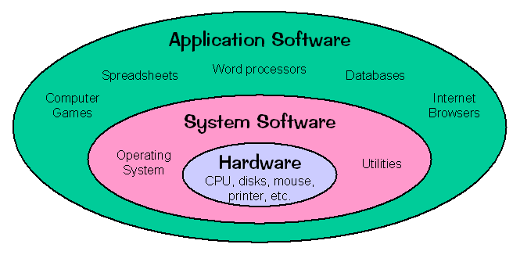
Computer System Structure^{.[3]}
Notes:
Cho1
Compiler translates high level programming language code to machine level code. Assembler converts the assembly level language to machine level code

Slide 8
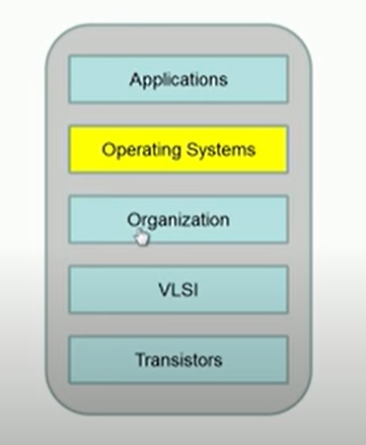
The layers Structure
Notes:
https://www.youtube.com/watch?v=a2B69vCtjOU

Slide 9
What is an os?²
Hardware Abstraction
  Well understood interface that hide all the details with in sub system
Resource Management
Notes:
https://www.youtube.com/watch?v=a2B69vCtjOU
Udacity:Lesson 1

Slide 10
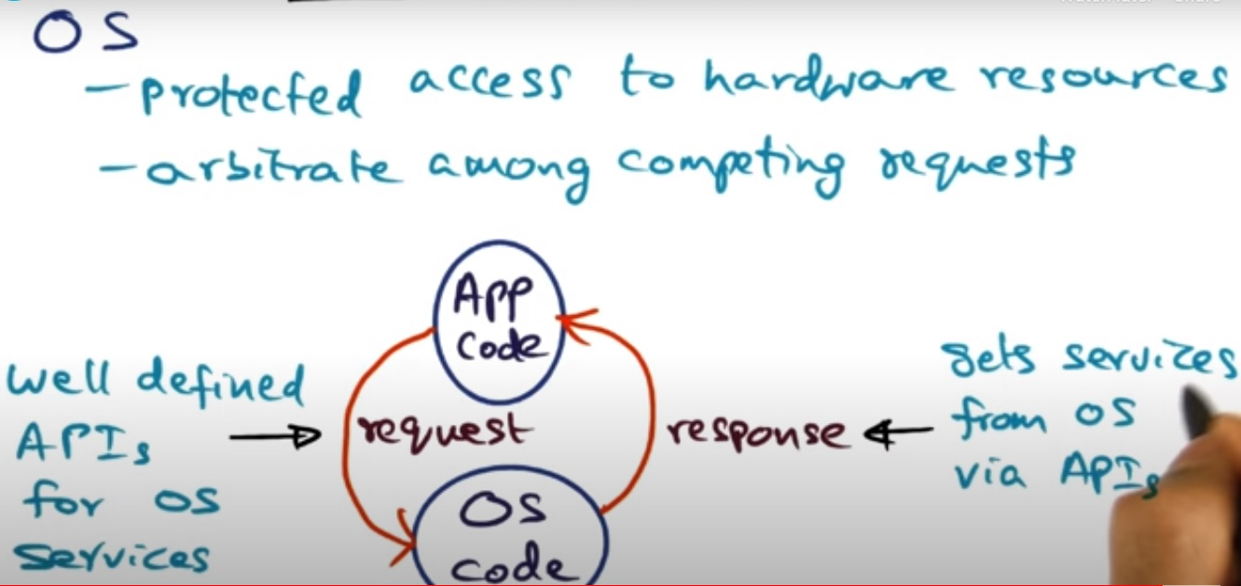
What is an os?²
Notes:
https://www.youtube.com/watch?v=uXp3xLKLjH8

Slide 11
What is an os?⁴
Top-down view ( external to OS)
  How user application see OS
  Provides an extended or virtual machine abstraction to user programs
  Easier to program than the underlying hardware.
  All services are invoked and accomplished through system calls.
Bottom-up view (Internal to OS)
  Acts as a resource manager of a complex system
  Resources consist of processors, memories, timers, disks, mice, keyboard, network interfaces, printers etc.
  OS manages allocation of these resources to user programs in an orderly and controlled manner
Notes:
A system call is a way for programs to interact with the operating system.
Bottom Up View: How the operating system provide service to application or check the internal structure of OS
Resource: keyboard etc
CS703 Lec 1:12:58

Slide 12
Resource Multiplexing ⁴
OS multiplexes resources in two ways:
  In time, In space
Time multiplexing involves different programs taking turns in using the resource. Example: CPU scheduling, printer sharing. • Space multiplexing involves different program getting part of the resource possibly at the same time. Example: memory is divided into several running programs.
Notes:
CS703 Lec 1
In resource allocation there is multiplexing. We take multiple inputs and base on some algorithm, we decided which input first go outside
Time M: allocate time slot to each application to use particular resource
Space M: different part of same resource use different application in same time

Slide 13
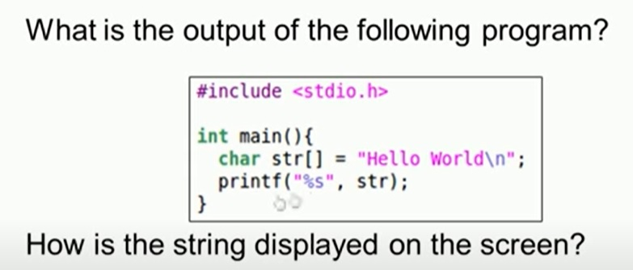
Simple Example
Notes:
https://www.youtube.com/watch?v=a2B69vCtjOU

Slide 14
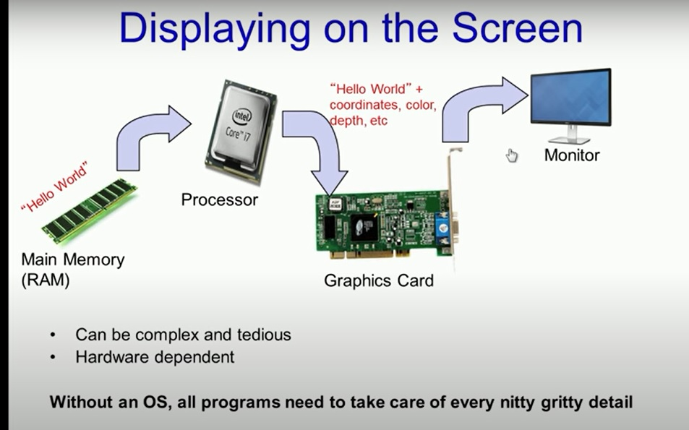
Simple Example
Notes:
https://www.youtube.com/watch?v=a2B69vCtjOU

Slide 15
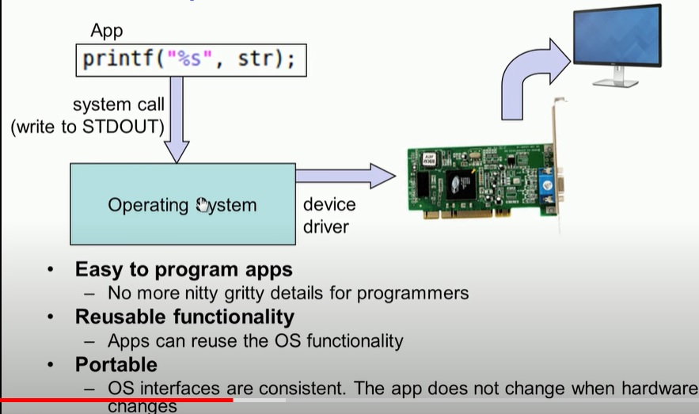
Simple Example
Notes:
https://www.youtube.com/watch?v=a2B69vCtjOU

Slide 16
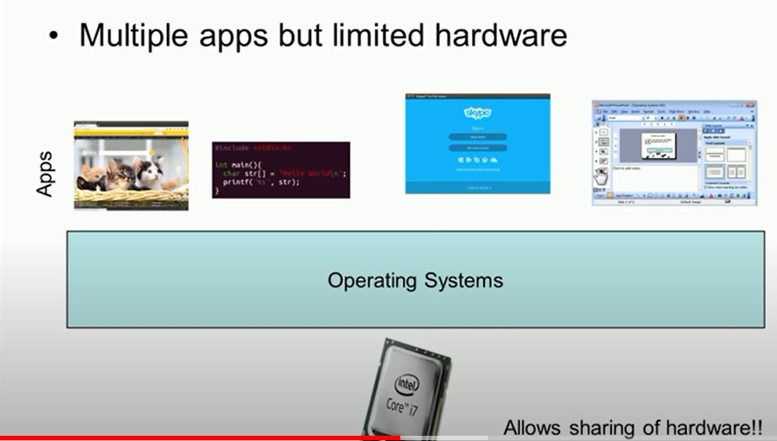
Simple Example (Resource Manager)

Slide 17
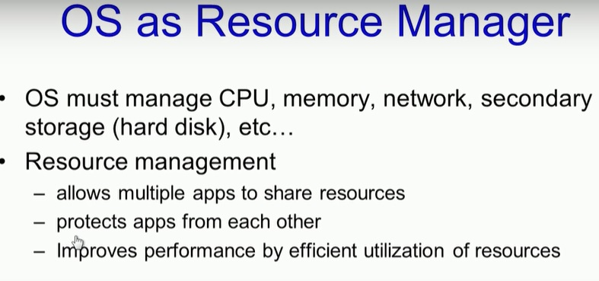
Simple Example (Resource Manager)

Slide 18
Questions
Which of the following is not an abstraction ?
  Door knob
  Number of pins coming out of chips
  And logic Gate
  Transistor
  Int Data type
Notes:
Udacity:Lesson 1

Slide 19
The Major issues of OS⁴
Structure: how is the OS organized?
Sharing: how are resources shared across users?
Naming: how are resources named (by users or programs)?
Security: how is the integrity of the OS and its resources ensured?
Protection: how is one user/program protected from another?
Performance: how do we make it all go fast?
Reliability: what happens if something goes wrong (either with hardware or with program)?
Extensibility: can we add new features?
Communication: how do programs exchange information, including across a network?
Notes:
Structure , how divide the OS in main system and then main system in to sub system
CS703 Lec 1

Slide 20
More OS issues⁴
Concurrency: how are parallel activates (computation and I/O created and controlled?
Scale: what happens as demands or resources increase?
Persistence: how do you make data last longer than program executions?
Distribution: how do multiple computers interact with each other?
Accounting: how do we keep track of resources usage, and perhaps charge for it?
Notes:
CS703 Lec 1

Slide 21
Protection and security as an example⁴
None - MSdos
OS from my program –pointer
Your program from my program
My program from my program –Threads
Access by intruding individuals
Access by intruding programs
Denial of service
Distributed denial of service
Spoofing
Spam
Worms
Viruses
Stuff you download and run knowingly (bugs, Trojan horses)
Stuff you download and run unknowingly (cookies, spyware)
Notes:
Denial of service : if web server only support 100 request per second and you give more request and other user do not have turn
CS703 Lec 1
Spoofing : when attacker enter through some address or name which is do not his name or address : IP spoofing
Worms: attack through network

Slide 22
Type of Operating Systems⁴
Main frame operating systems
  Huge amounts of I/O activity.
  1000s of disks not unusual
  Batch processing is routine non-interactive jobs. e.g. claims processing, sales reporting etc.
  Transaction processing systems handle large number of small requests e.g. check processing in banks, air line reservations etc.
  Time-sharing systems allow multiple remote users to run jobs at the same time e.g. querying a database. OS Optimized for these tasks. Example is OS/390- IBM
Notes:
CS703 Lec 1: 42.55

Slide 23
Type of Operating Systems⁴
Server operating systems
  Run on very large PCs, workstations or even main-frames. They serve multiple users over a network simultaneously and allow them to share hardware and software. Examples are web servers, database transaction servers etc.
  Examples of OS in this class are Win2K, XP and flavors of UNIX.
Notes:
CS703 Lec 1

Slide 24
Type of Operating Systems
Multiprocessor operating systems
  OS is basically a variation to server operating systems with special provisions for connectivity and communication management between different CPUs.
PC operating systems
  OS provides a nice interface to a single user.
  Typically used for word processing, spread sheets, Internet access etc.

Slide 25
Type of Operating Systems
Real-time operating systems
  Characterized by time as the key parameter. Real-time response to internal and external events is more important than any other design goal. Classified into two sub-categories: Hard and Soft real-time.
Example applications include Industrial process control, robotics and assembly lines, air traffic control, network routers and telecommunication switches, multi-media systems etc.

Slide 26
Type of Operating Systems
Embedded operating systems
  Embedded in small devices e.g. palm-top computers e.g. PDA (Personal Digital Assistant), TV sets, micro-wave ovens, mobile phones. They have characteristics of real-time systems (mainly soft real-time) but also have restraints on power consumption, memory usage etc. ✓
  Examples include PalmOS and Windows CE. Height of this type is smart-card systems
Notes:
A Palmtop PC was an approximately pocket calculator-sized, battery-powered computer compatible with the IBM Personal Computer in a horizontal clamshell design with integrated keyboard and display.
A personal digital assistant (PDA), also known as a handheld PC, is a variety mobile device which functions as a personal information manager. PDAs have ...

Slide 27

Home work

Slide 28
Home Works
https://docs.google.com/document/d/1hKIa-FYfXqtSWzFNZ7GSpt45cb8IVXc8myspJn_F9E0/edit#heading=h.qqbrjp86gnem

Slide 29
References
[1] CS703 Advanced Operating System
https://www.youtube.com/watch?v=ADd4VQ6_owI&list=PL9A3A425C6124EEDA
[2] Advanced Operating System
https://classroom.udacity.com/courses/ud189/lessons/3652509443/concepts/6416592080923
[3] Operating System Concepts, 7th Edition
Cho1:http://bcs.wiley.com/he-bcs/Books?action=resource&bcsId=2217&itemId=0471694665&resourceId=5004
[4] Advanced Operating System
https://ocw.vu.edu.pk/Videos.aspx?cat=Computer+Science%2fInformation+Technology+&course=CS703

