Slide 1
Machine Learning(DL)
Mahdi Academy

Slide 2
Instructor and Timing
Instructor: Dr. Mushtaq Hussain
Email: hussain0048@shu.edu.cn
Timing : Thursday , 06:30-9:30
Website:
  :

Slide 3
Outline
What is NI
What is AI?
What is ML
How ML Works
Supervised learning
Unsupervised learning
Logistic regression and its cost functions
Gradient Descent, Derivates

Slide 4
Natural Intelligence (NI)
NI is the intelligence naturally evolved in living beings in responses to the level of complexity in problems, challenges etc
Helps in “ What to do ,When we don not knows what to do”
Humans , animals, brids etc
Thought,Vision, Speech, Hear, Feel

Slide 5
What is Artificial Intelligence ?
AI is the simulation of human intelligence by machines
According to the father of AI , John McCarthy “ The science and engineering of making intelligent machines, especially intelligent computer programs”
AI is not nature
Thought: Facebook use artificial neural network for facial recognition
Speech and Hearing: Google Assistant , Siri
Vision :Capturing traffic Violations
Notes:
AI is the branch of computer science ; which deals with building intelligent agents(System), which can be able o solve problem, and evolve by themselves

Slide 6
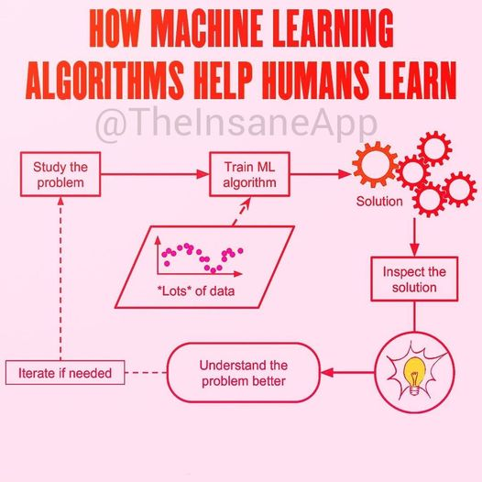

Slide 7
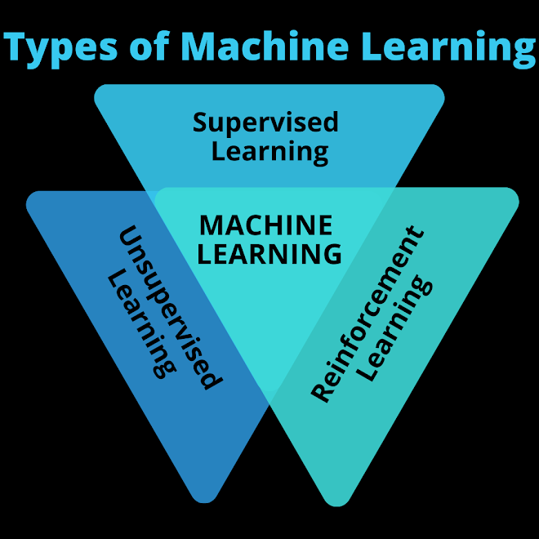
Types of ML

Slide 8
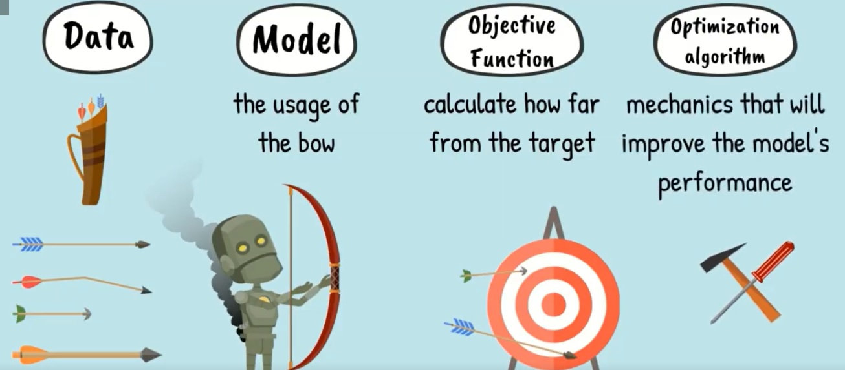
How ML works ?

Slide 9
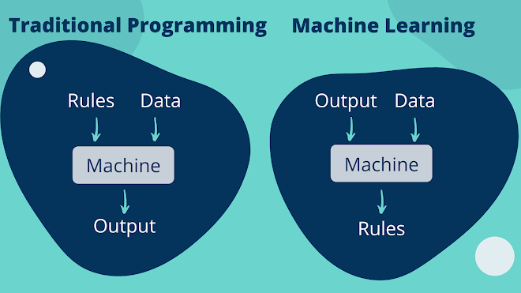
How ML works

Slide 10
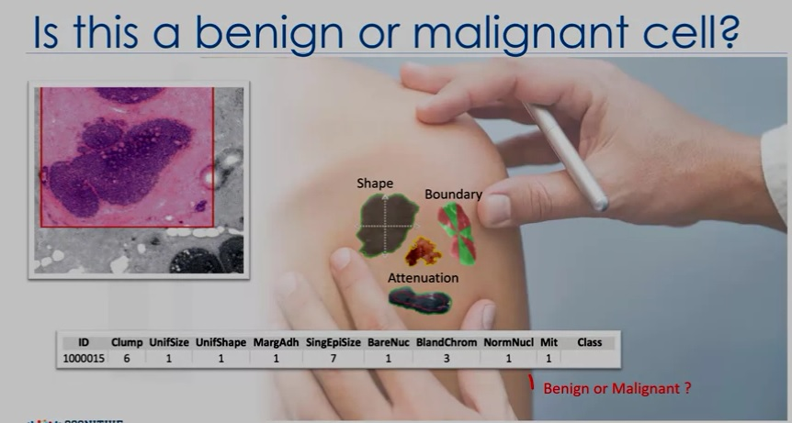
How ML works ?

Slide 11
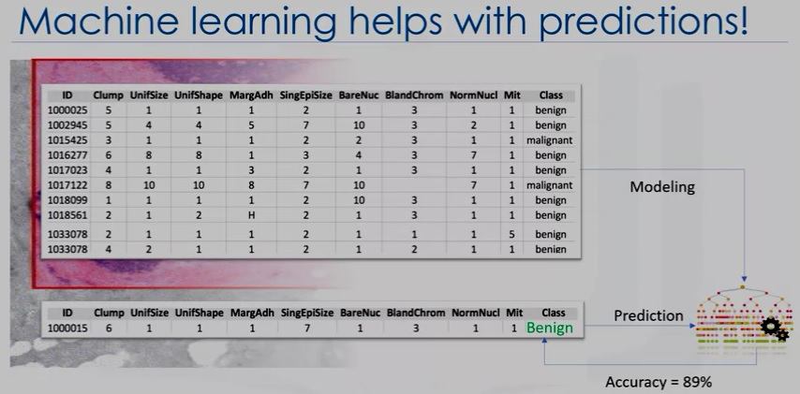
How ML works ?

Slide 12
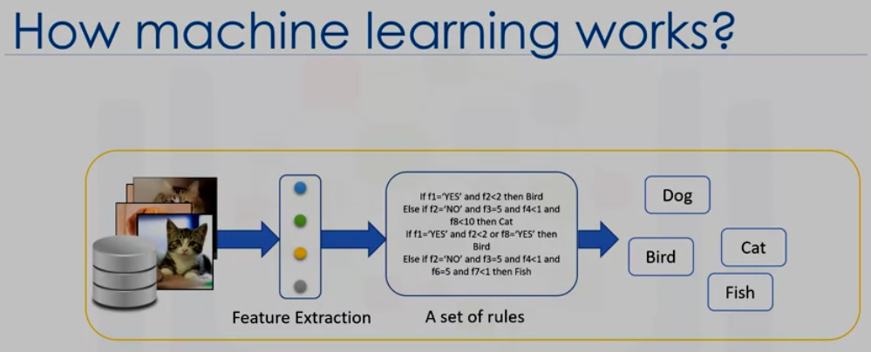
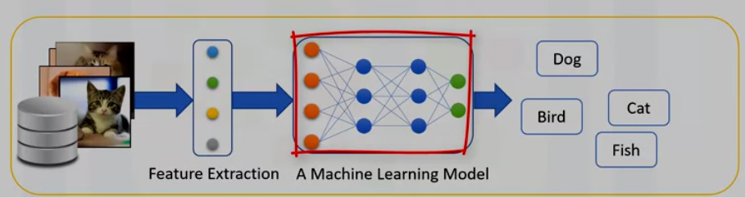
How ML works?

Slide 13
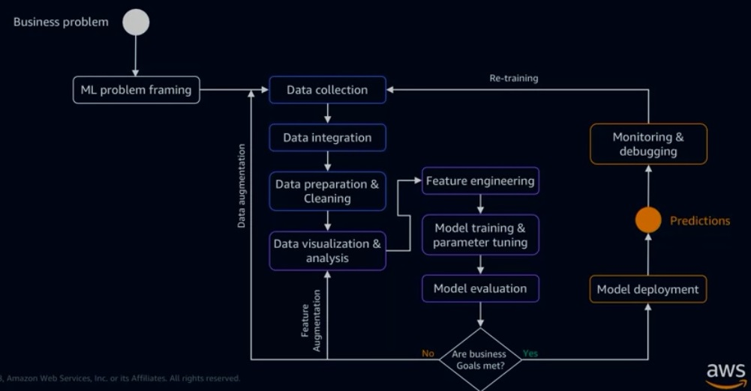
ML Process

Slide 14
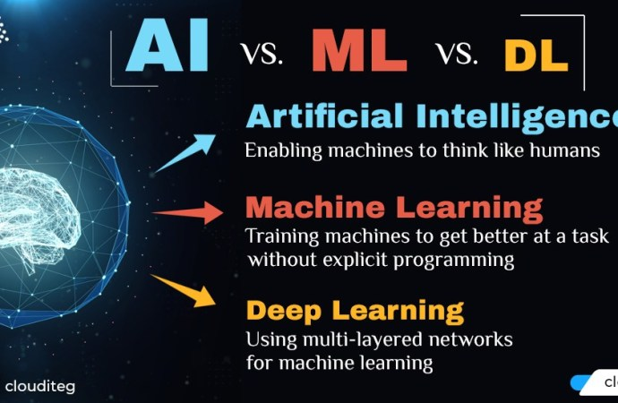
AI, ML,DL
Notes:
https://cloudit-eg.com/artificial-intelligence-ai-vs-machine-learning-vs-deep-learning/?fbclid=IwAR0Tcr8q_hfODyD2ZJBgfCJQJVN2QP0r8RynsFFQcRlBAPhUhV0KJiIyX_E

Slide 15
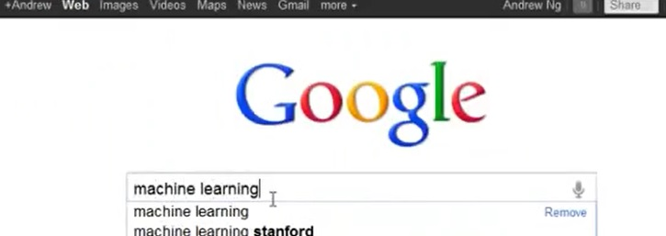

Application of ML¹
Webpage Ranking
Facebook and Apple Photo Tagging
  Recognized Friend photo
Spam Filter
Notes:
lec1

Slide 16
Why ML¹
Machine Learning –
  Grew out of work in AI –
    Only for short path
  New capability for computers
    Computer Can See , Google searching etc
    Machine doing by it self
  Examples:
  - Database mining Large datasets from growth of automation/web. E.g.,
    Web click data, medical records, biology, engineering
  Applications can’t program by hand. E.g.,
    Autonomous helicopter, handwriting recognition, most of Natural Language Processing (NLP), Computer Vision.
  Self-customizing programs E.g.,
    Amazon, Netflix product recommendations
  Understanding human learning (brain, real AI).
Notes:
Lec1

Slide 17
What is ML¹ ?
Machine learning as the field of study that gives computers the ability to learn without being explicitly programmed. (Arthur Samuel (1959)
He says, a computer program is said to learn from experience E, with respect to some task T, and some performance measure P, if its performance on T as measured by P improves with experience E (Tom, 1998)
:
Notes:
Lec2
I actually think he came up with this definition just to make it rhyme. For the checkers playing example the experience E, will be the experience of having the program play 10'sof 1000's of games against itself. The task T, will be the task of playing checkers. And the performance measure p, will be the probability that it wins the next game of checkers against some new opponent.

Slide 18
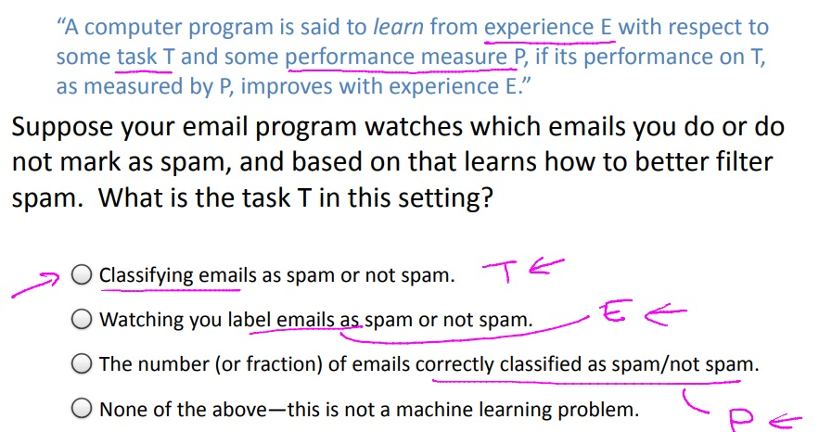
What is ML¹?
Notes:
lec2

Slide 19
Type of ML algorithems¹
Machine learning algorithms: -
Supervised learning
  Teach to computer what to do
Unsupervised learning
  Learn by itself
Others: Reinforcement learning, recommender systems.
Also talk about: Practical advice for applying learning algorithms.
Notes:
Lec2

Slide 20
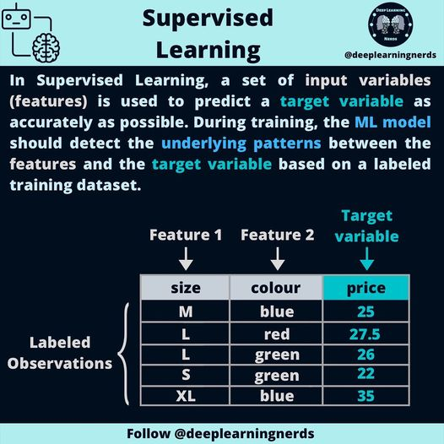
Supervised Learning

Slide 21
References
[1] Machine_Learning(Andrew Ng)
https://www.coursera.org/learn/machine-learning

