Slide 1
Multivariable calculus

Slide 2
WHAT IS CALCULUS?
Calculus is the mathematics of motion and change. Where there is motion or growth. Mathematics concerned with describing the precise way in which changes in one variable relate to change in another.

Slide 3
Multivariable calculus
In calculus, multivariable calculus is the extension of regular, one-dimensional calculus to more than one dimension. Most of the concepts from calculus, such as continuity and chain rule, still work in more than one dimension.

Slide 4
Function
Function, in mathematics, an expression, rule, or law that defines a relationship between one variable (the independent variable) and another variable (the dependent variable).
Functions are generally represented as f(x)
Let , f(x)= x³
Functions can also be represented by g(), t(),… etc.

Slide 5
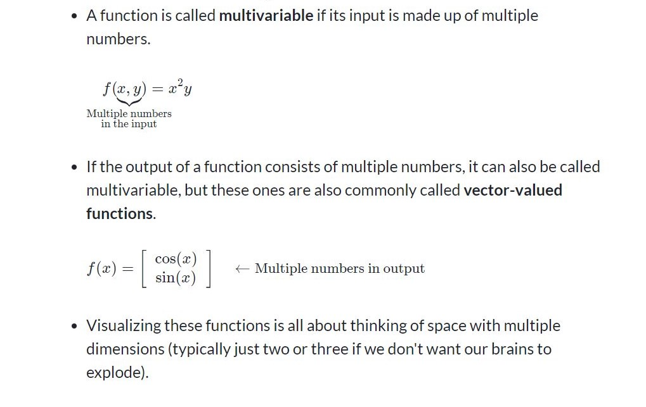
Multivariable function

Slide 6
Multivariable function
A multivariable function is just a function whose input and/or output is made up of multiple numbers. In contrast, a function with single-number inputs and a single-number outputs is called a single-variable function.
Note: Some authors and teachers use the word multivariable for functions with multiple-number inputs, not outputs.

Slide 7
Example of different types of functions
 | Single-number input | Multiple-number inputs
Single-number output | f(x)=x² | f(x,y)=x²+y³
Multiple-number output | f(t)=(cos(t),sin(t)) | f(u,v)=(u²−v,v²+u)

