Slide 1
Advance Operating System

Slide 2
Today’s Agenda
I/O Interface in computer organization
Principles of I/O Software
Synchronous vs. asynchronous Operation
Device Controllers
Device Controllers tasks
layers of the i/0 system
memory mapped i/o vs Direct i/o

Slide 3
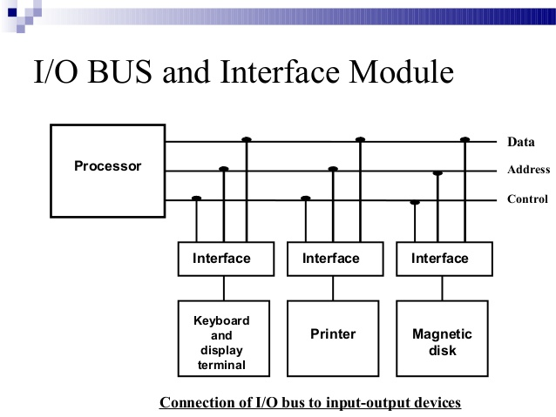
I/O Interface in
Computer Or`ganization
  Speed
  Signals
  Format

Slide 4
Principles of I/O Software
Layer or Interface
Goals of I/O Software
Device independence
  programs can access any I/O device without specifying device in advance (floppy, hard drive, or CD-ROM)
Uniform naming
  name of a file or device a string or an integer not depending on which machine
Error handling
  handle as close to the hardware as possible
Synchronous vs. asynchronous transfers
  blocked transfers vs. interrupt-driven
Buffering
  data coming off a device cannot be stored in final destination immediately
Notes:
CS703-35

Slide 5
Device Controllers
It is component which control device
Every I/O devices have components:
    mechanical component( Ball of mouse)
    electronic component
Movement of mechanical are translate to electrical signal >Electronic data> store in memory
LCD
  Data transmit(memory or register)> go inside LCD> Convert in electrical signal >paint dot
To control this process
  Device have chips >device controller
  Control the operation inside device
  Contain CPU , Hard code logic
Notes:
CS703-35

Slide 6
Device Controllers tasks
convert serial bit stream to block of bytes
perform error correction as necessary
make available to main memory
Notes:
CS703-35

Slide 7
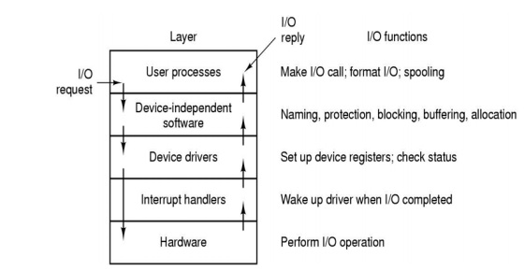
Layers of the I/O system and the main functions of each layer

Slide 8
Layers of the I/O system and the main functions of each layer
User Process layers
  It call I/0 or System Call
  Maintain quee if the Printer are busy
Device Independent Layer
  Resolve device name
    It resolve the file type name to actual device name
  Protection
    It control the device access
  Blocking –synch and aSynch
  Buffering
  Allocation
    Device allocation to process

Slide 9
Layers of the I/O system and the main functions of each layer
Device driver
  Program to Device Controller
    Give data , take data
  Check status
    Is it working or not
Interpret handler
  It is lower level routine
Hardware
  It is actual hardware

Slide 10
Memory mapped I/O
Vs Direct I/O
Memory mapped I/O
  Device controller‘s registers and internal memory are directly mapped into the processor‘s address space
  Commonly used in now days
  Device access become simple memory access
  User can easily access device register with pointer
Direct I/O
  Device controller‘s registers and internal memory is accessible via special instructions in the assembly language instruction set. The arguments to these instructions are usually called ports.
  Common in old days

